Slide 1

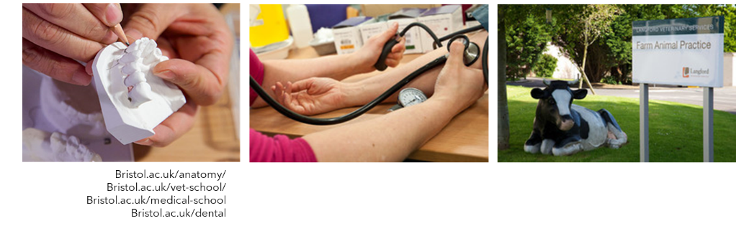
Medicine, healthcare/Allied health (dentistry/vet/med) -Allison Fulford
Gateway Programmes in Medicine, Dentistry and Veterinary Science
School of Anatomy

Slide 2
How can you/we best support students with enhancing their applications for clinical or healthcare programmes?
Encourage students in finding relevant work experience when possible: e.g. shadowing professionals
Volunteering, community/care work, team-working, hobbies showing manual dexterity or training commitment, part-time/saturday work
Important to encourage reflection upon those experiences: what they have learnt about themselves and how they might be useful and transferable?
University of Bristol offers opportunities and tasters for pre-16 and post-16 students

Slide 3

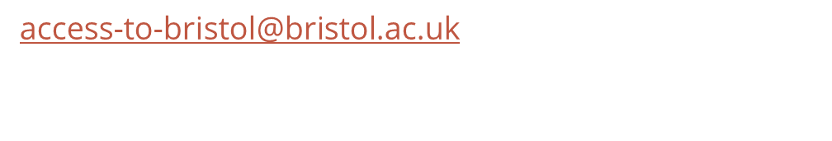
Widening participation Schemes at the University of Bristol
Pathways to Health Sciences
Offers local Year 12 students a series of workshops at the university to discover more about Dentistry, Medicine or Veterinary Sciences at the University of Bristol.
Venture into Vet
For students in year 10 and 11, focuses on the varied careers available to vet students, as well as offering insight into pathways into vet school.
Sutton Trust Summer School and Insight into Bristol (both residential summer schools for year 12 students)
insight-into-bristol@bristol.ac.uk

Slide 4
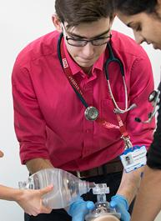
Pathways to health sciences
Widening participation scheme designed to give local Year 12 and Access to HE students an insight into our Health Science programmes
Suitable for students studying Chemistry & another lab-based science at A-level or an Access to HE qualification. Students should also meet the relevant GCSE requirements.
Taster sessions delivered by academics, NHS Clinicians, and current students. Opportunity to practice clinical skills and talk to professionals from the chosen field.
PHS Programme provides personal statement and interview workshops to help prepare students for applications to university.
apply online between September
at: bristol.ac.uk/access-to-bristol
Contact Kath Bourne (Pathways to Health Sciences Coordinator) at pathways-to-health-sciences@bristol.ac.uk.

Slide 5
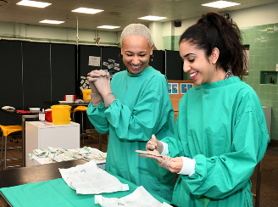
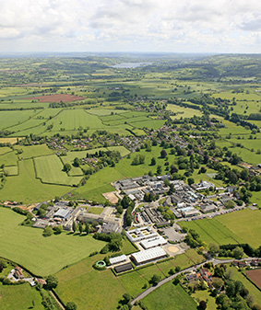

Venture into Vet
Venture into Vet is a series of events, both in-person and virtual, for students in Year 10 and 11.
Student Resources- Venture into Vet Careers
Resources available to find out more about the Veterinary profession and how to become a Vet or Vet Nurse.
Online courses and work experience
Students can find out more about the Veterinary profession by enrolling on a free online course:
Future Learn: Exploring the Veterinary Profession and Virtual Work Experience

Slide 6
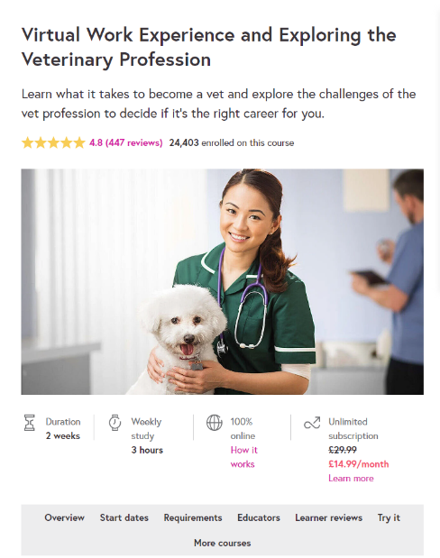

https://www.bristol.ac.uk/study/outreach/
Bristol.ac.uk/vet-school
Bristol.ac.uk/dental
Bristol.ac.uk/medical-school

