Slide 1

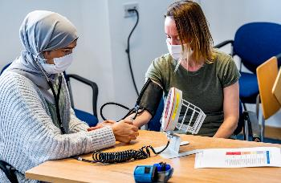
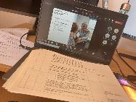
Developing Talent Lead: LifeLab
LifeLab Summer School
LifeLab Days
Youth Panel
Widening Access to Medicine Taster Course
Virtual Work Experience

Slide 2

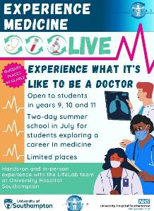
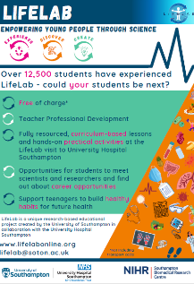
Pre 16
2 day in person course at University Hospital Southampton for students interested in becoming a doctor (24th & 25th July)
Youth Panel for students aged 14-18, paid role for students interested in health choices
Science for Health module of work for Year 9 students, including a day visit to the LifeLab facility at Southampton General Hospital - offered throughout the year, curriculum based lessons supporting healthy habits for the future

Slide 3
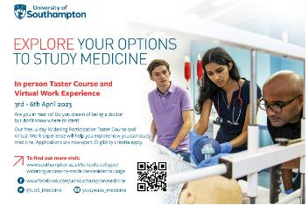
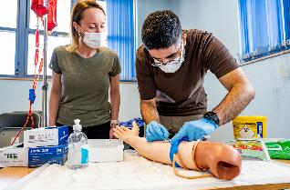
Post 16
4 day in person and online course for Year 12 students interested in accessing a medicine course through a Widening Participation route. Combines in person activities, application and admission advice and virtual work experience.
Virtual Work Experience for Year 12/13. Collaborative project with UHS to offer live virtual work experience for 2 days 5 times throughout the year.
A level and BTEC activity days at LifeLab – offered throughout the year – self-funded or supported via WPSM

Slide 4
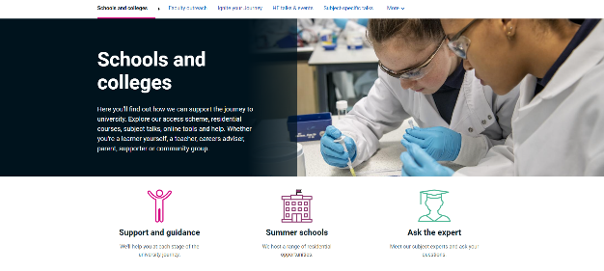
Further Information
Working with schools and colleges | University of Southampton
www.soton.ac.uk/schools-colleges
www.lifelabonline.org
LifeLab@soton.ac.uk

