Slide 1




Slide 2
Student Inclusion
Here to support underrepresented groups of students and help them to take up the opportunities available at university.
We are part of the Widening Participation and Social Mobility Directorate.
Projects include:
Mature Student Work
Awarding Gap Project
Support for Care Leavers and Estranged students
Student Advisory Board
Ignite Your Success
Social Mobility Network
Notes:
SC

Slide 3
Care Leaver & Estranged Student Support
Our support for care leavers and estranged students includes:
  Access to year-round halls accommodation
  £2,000 bursary payable each academic year, in addition to any other funding they’re eligible for
  Welcome pack including gift vouchers to aid transition to university
  Regular 1:1 pastoral support with a consistent point of contact
  To discuss the support available in more detail, please email studentinclusion@soton.ac.uk

Slide 4
Commuter Fund
The Commuter Fund offers up to £200 to eligible students who remain living at home, to help over the costs of travelling to university.

Slide 5
Ignite Student Lifecycle
Ignite Southampton Community
Ignite Your Potential
Ignite Your Journey (A2S)
Ignite Your Success
Vice-Chancellor’s Progression Scheme
Access work with care experienced students in year 10/11
Access work with year 12/13 students who meet specific WP criteria
3-year programme for care-leavers and students from IMDQ1 backgrounds
Financial and pastoral support for Masters students meeting specific WP criteria
Transition

Slide 6
What Is Ignite?
3 year alumni-funded programme
Scholarships, bursaries and awards funded through donations sourced by ODAR
Range of activities to support educational and personal development
Notes:
SC
15 awards
13 bursaries
2 scholarships

Slide 7
Who can apply?
UK based, First Year Undergraduate
Care Leaver
IMD Q1
Ignite Your Journey Students
Free School Meal Eligible
Notes:
EG
Ignite is open to UK students in their first year of their undergrad degree who fall under one of three categories: IMDQ1, Care leaver and IYJ students . All eligible students have been invited to apply via email.
This is your only opportunity to apply to Ignite Your Success so seize this opportunity!

Slide 8
Ignite Supports Students To…​
Connect with peers
Develop employability skills
Thrive academically
Connect with alumni and prospective employers
Engage in extra-curricular activities
Explore postgraduate study
Explore international opportunities
Develop physical and emotional wellbeing
Manage the costs of university
Notes:
EG

Slide 9

Financial Support
Notes:
SC
Ignite Programme comes with financial support including:
Scholarship
Bursary
Award
Paid in instalments, over three years, to provide extra income while studying. You might choose to spend this on living costs, course materials, help you pursue other opportunities e.g. study abroad

Slide 10

Peer Support
Notes:
SC
Opportunity to be mentored by and in turn, mentor, your peers
Want you to be part of building the Ignite community, chance to shape our social activity

Slide 11

Academic Support
Notes:
SC
Work with academic skills hub

Slide 12

Career Development
Notes:
SC
Guaranteed internship
Career workshops every year
Exclusive career mentoring offer

Slide 13

Physical and Emotional Wellbeing Support
Notes:
SC
Even some budgeting skills, linking up with Enabling, feeding students content from them from NHS 5 steps to wellbeing
Pastoral support- 1-1s

Slide 14

Networking Opportunities
Notes:
EG
Chance to connect with alumni and future employers through our workshops
Giving circle events

Slide 15
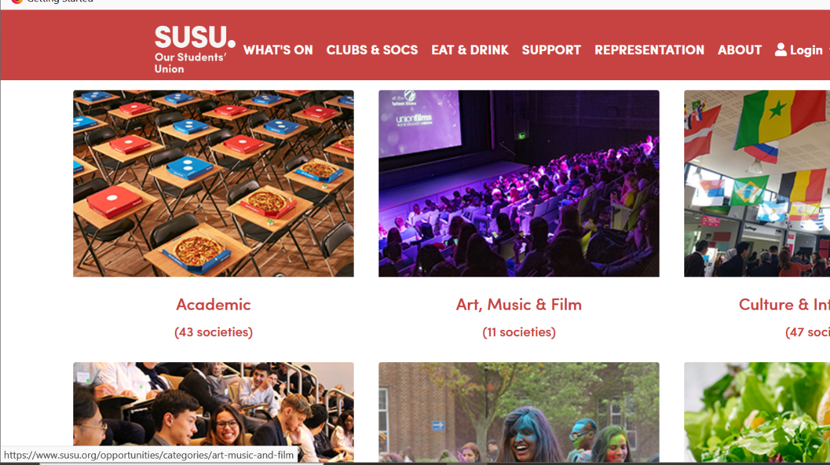
Extra Curricular Activities
Notes:
EG
Encourage students to take part in extra-curricular activities such as SUSU clubs and socs, develops transferable skills

Slide 16

Explore Post Graduate Study
Notes:
EG
Development of Ignite Your Future programme opens up opportunities to those interested postgraduate study such as a Masters or PhD

Slide 17

Mentoring
Notes:
EG
We offer mentoring for every stage your studies:
Peer mentoring in year 1
E-mentoring in year 2
Career mentoring in year 3

Slide 18
What Does Support Look Like?
6 workshops throughout the year
1:1 support with Ignite Coordinators
Targeted opportunities throughout the year
Online community
Notes:
SC

Slide 19
Application Process
Apply in September- October
Fill out online form or record answers as a video/audio file
Notified within 7 days of closing
Interview to establish places following applications
Notes:
EG
To apply, follow the link in your invitation email or find it on our website. Fill out the online form. You also have the option to record your answers as a video or audio file and send it to the ignite inbox. We’re not judging the production quality of your video, we just need to be able to hear your answers.
You’ll be notified of the outcome within 7 days of the deadline. If successful, we’ll invite to interview which will help us decide what financial support you might benefit from and which mentor to match you with

Slide 20



Contact Us
ignite@soton.ac.uk
www.southampton.ac.uk/ignite
@ignite_Southampton
Notes:
EG

Slide 21
Any Questions?
Notes:
SC

