Slide 1

Widening Participation & Gateway Programmes
Dr Allison Fulford
University of Bristol,
School of Anatomy
a.j.fulford@bristol.ac.uk
bristol.ac.uk>

Slide 2

What is Widening participation?
Why does it matter?

Slide 3

Challenging bias, promoting opportunity, breaking barriers
Widening access seeks to increase intake of students from..
  Disadvantaged backgrounds
  Lower income households
  Under-represented groups
Notes:
.

Slide 4


Equality, diversity and inclusion
MSC EDI Alliance (2021)
Active Inclusion: Challenging exclusions in medical education (medschools.ac.uk):
  Making medical schools accountable
  Challenging exclusion in recruitment & selection, and the medical school environment
  Challenging exclusions in the curriculum
  Challenging exclusions in clinical placements

Slide 5
How we can help?
Provide support for aspiring medical students from Widening Participation backgrounds through their medical course and transition to working as doctors
Share ideas, good practice, raise issues, advise on applications
Student finance and support for student hardship
Raise awareness of the needs of WP medical students eg through collaboration (e.g. Medical Schools Council (MSC) )

Slide 6
Widening access to Medicine
~36 UK Medical Schools
~20 HEIs offer Gateway/Foundation programmes
Aim: To highlight the barriers to Medical Professions and how we can tackle them together to the benefit of students

Slide 7

6 year Gateway Programmes at University of Bristol
A108 Gateway to Medicine
B208 Gateway to Dentistry
D108 Gateway to Veterinary Science
https://www.bristol.ac.uk/study/undergraduate/entry-requirements-qualifications/contextual-offers/

Slide 8

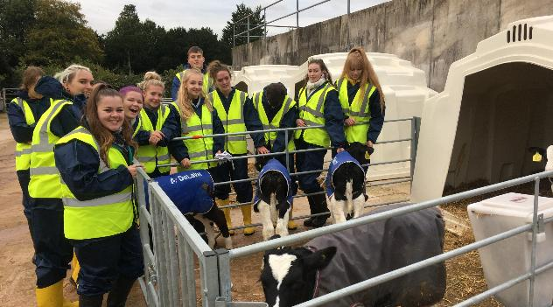


Slide 9
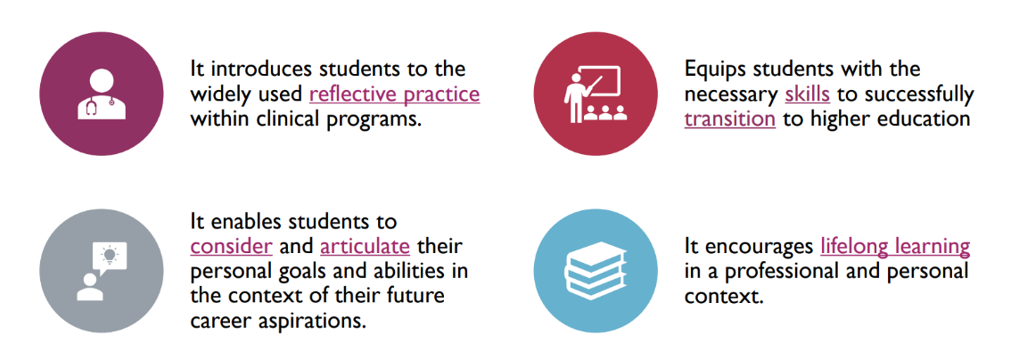
Gateway/Foundation courses include an enrichment year for developing scientific knowledge, professionalism and skills

Slide 10
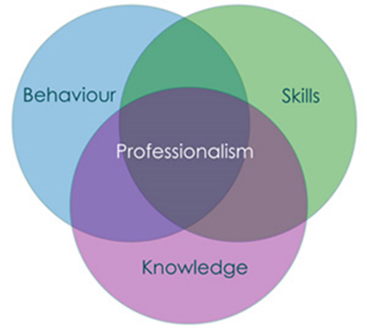
Gateway Programmes at University of Bristol
Combined Gateway year
Foundation course for MBChB, BDS and BVSc
Opportunities for interprofessional learning
Observational placements
Near-peer mentoring
Wellbeing support
High progression rates to clinical courses

Slide 11
What other types of WP schemes exist?
  University outreach projects
  Summer schools
  Guaranteed offer schemes
  Contextual offers

Slide 12


Widening participation Schemes at the University of Bristol
Pathways to Health Sciences
Offers local Year 12 students a series of workshops at the university to discover more about Dentistry, Medicine or Veterinary Sciences at the University of Bristol.
Sutton Trust Summer School and Insight into Bristol (both residential summer schools for year 12 students)
insight-into-bristol@bristol.ac.uk

Slide 13
How you can help us
Identify and discuss specific barriers WP students face when applying to university
Signpost your students to our resources and university websites for further information on admissions and our courses
Encourage your students to join WP/outreach schemes

Slide 14

Want to know more?
Sign up for the University of Bristol Schools and Colleges newsletter
Outreach | Study at Bristol | University of Bristol
Find out more:
bristol.ac.uk/medical-school

Slide 15

Thankyou for listening!

