Slide 1
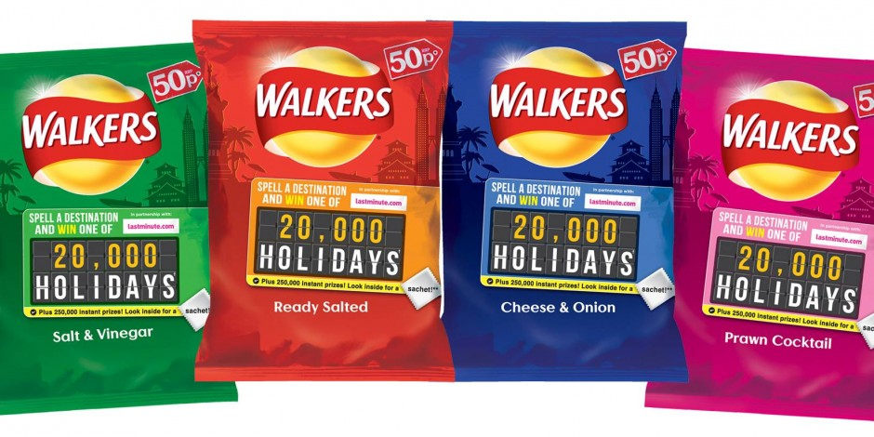
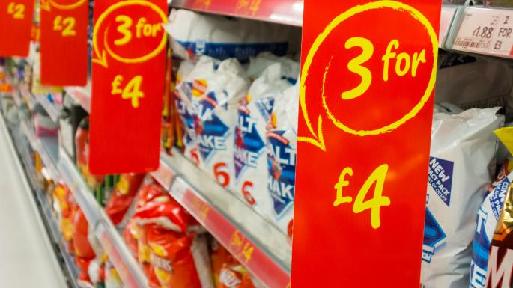
Competition Promotion
Some companies display competitions with enticing high-end prizes on the front of their packaging in order to attract consumers.
Discussion point:
Should producers of unhealthy foods be allowed to entice consumers with the possibility of winning a competition through purchasing the product?
Supermarket Bulk Buy Offers
Tempting displays of products in the supermarket with large special offer signs. Examples of this include buy one get one free, and bundle offers for reduced prices.
Discussion point:
What foods should supermarkets be allowed to offer on these promotions? Should they be allowed to offer unhealthy foods?

Slide 2
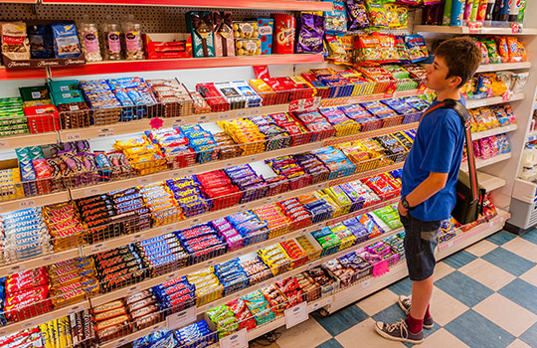
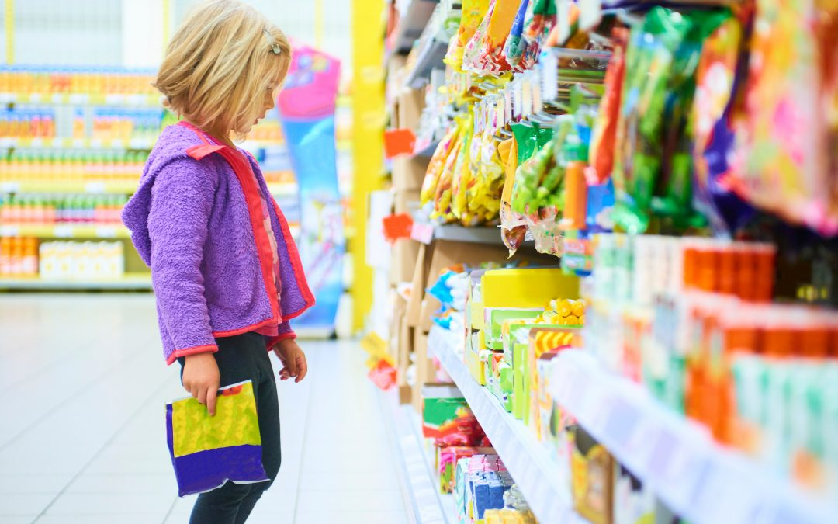
Product placement in local shops
Very often, when you walk into your local corner shop, the sweets and chocolates are on a prominent and very large display where they can be seen clearly on both entry and exit of the shop. Petrol stations use a similar tactic.
Discussion point:
How does this product placement affect the food choices children make on their way to and from school?
Product placement in supermarkets
Supermarkets place products aimed at children lower down on their shelves so that they are eye level with children. Retailers rely on ‘pester power’ – that the child will be drawn to the product and pester their parent for it.
Discussion point:
Who do you think is responsible for this product placement? – Supermarkets or advertising teams for the products?

Slide 3
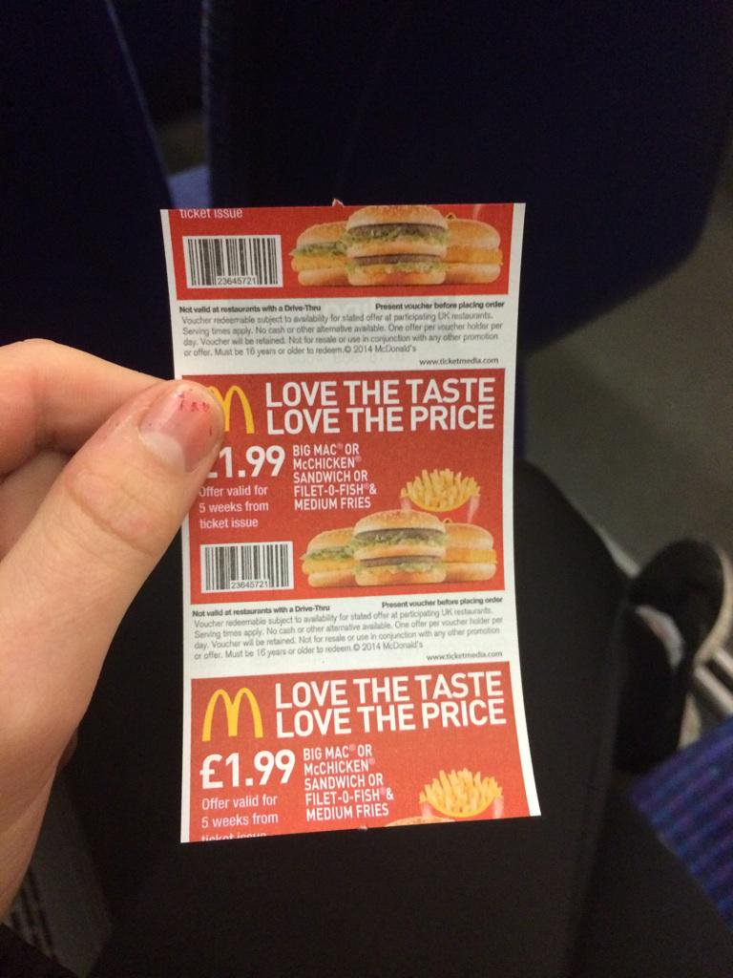
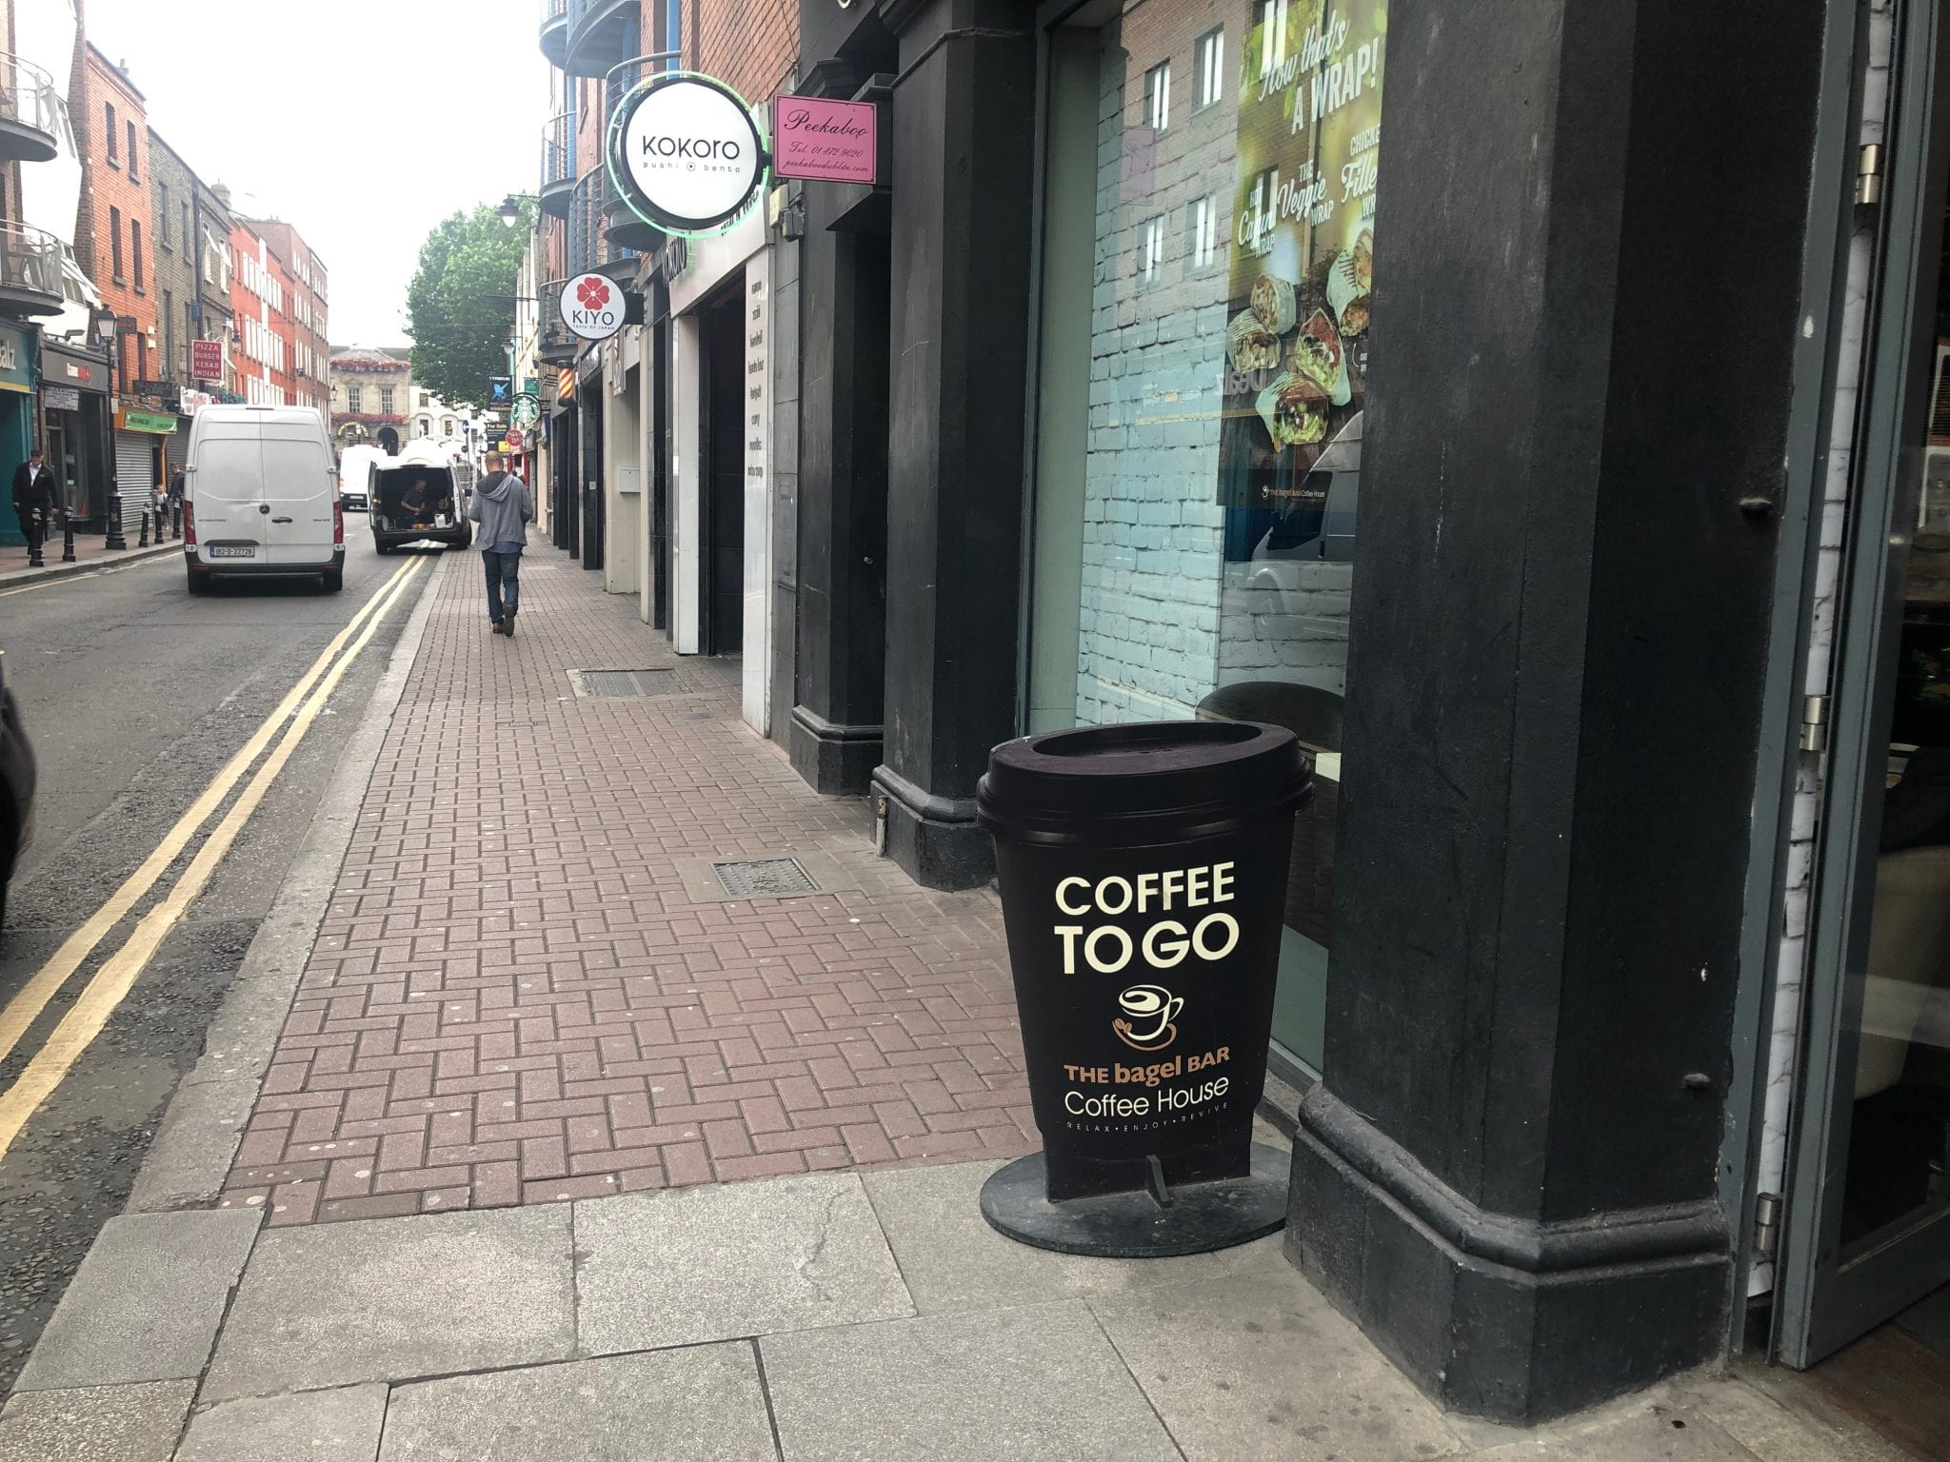
Advertising on bus tickets
Producers of fast food often buy up advertising space on the back of bust tickets. This space is often used to offer junk fast food at a reduced price or bulk buy offer.
Discussion point:
If you were the owner of the bus company, would you continue to allow this to happen? What else could the advertising space be used for?
A-board advertising on high street
Cafes, shops and eateries use A-boards placed outside their premises on the street to advertise products and product promotions in the hope that passers by will be lured in to buy their product.
Discussion point:
How often do you notice these signs? How do you get drawn in from seeing these signs? Who do you think these advertisements are aimed at?

Slide 4
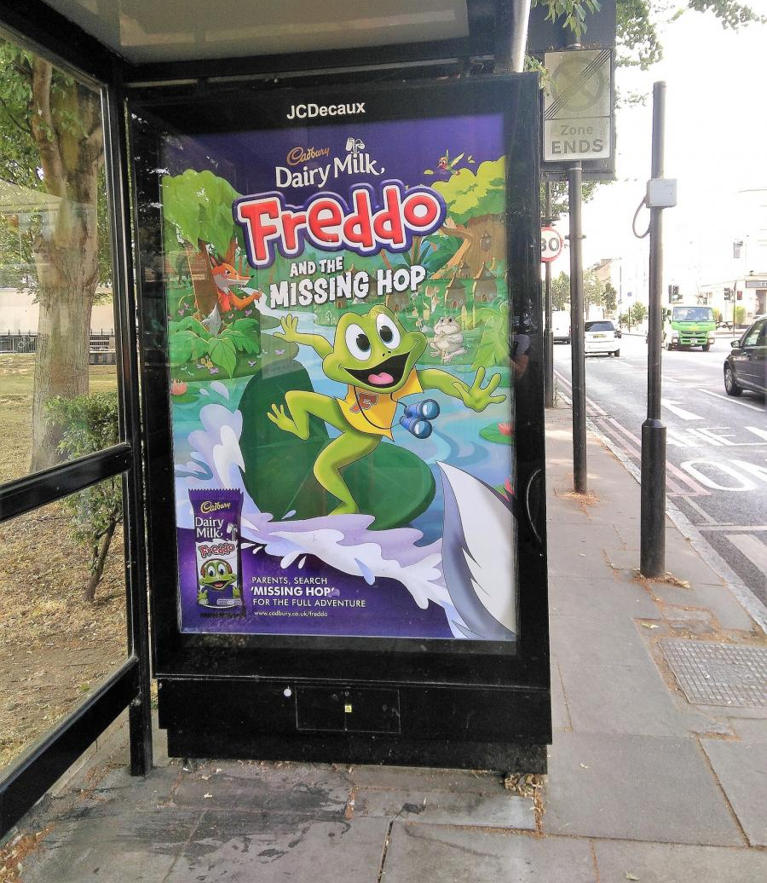
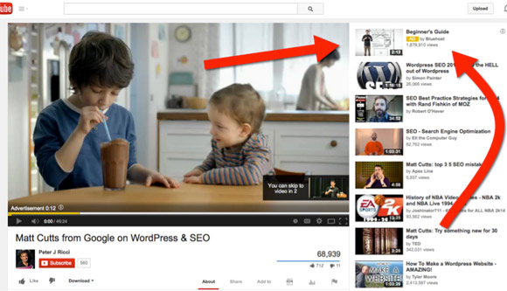
Bus shelters and billboards
Companies often use shelters or large billboards on the street to advertise products and product promotions in the hope that passers by will be lured in to buy their product.
Discussion point:
How often do you notice these signs? How has a product drawn you in from seeing these signs? Who do you think these advertisements are aimed at?
YouTube
Based on your browsing history and use of cookies, etc. platforms such as YouTube, Instagram and Facebook use targeted advertisements to attract your attention. These pop up in specific locations as you browse in order to deliberately catch your attention.
Discussion point:
How much control do you feel you have over these pop-up advertisements? Do you think it is an invasion of your privacy?

Slide 5
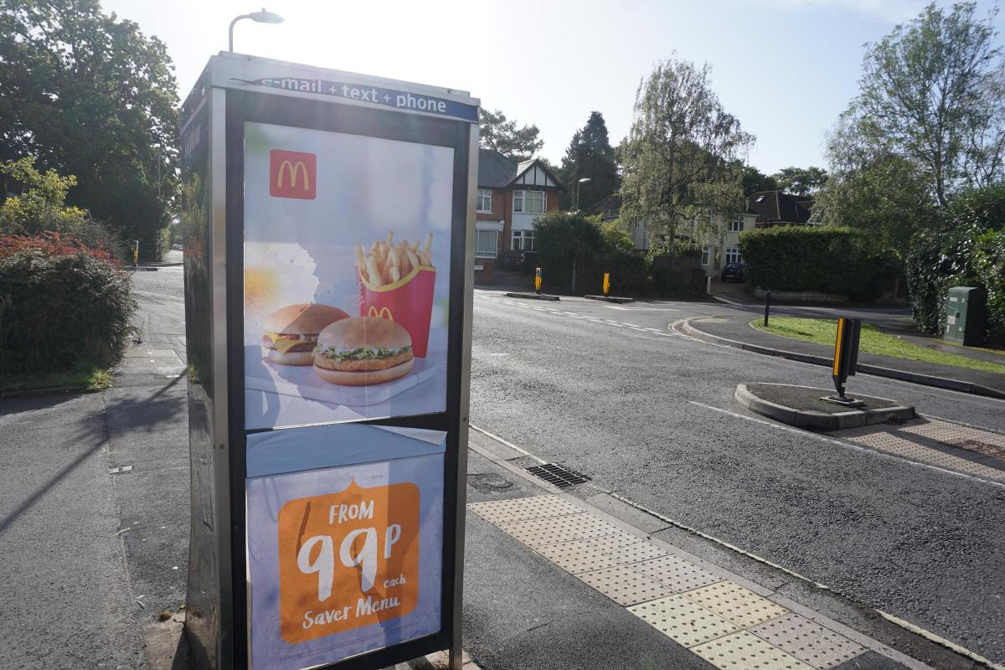
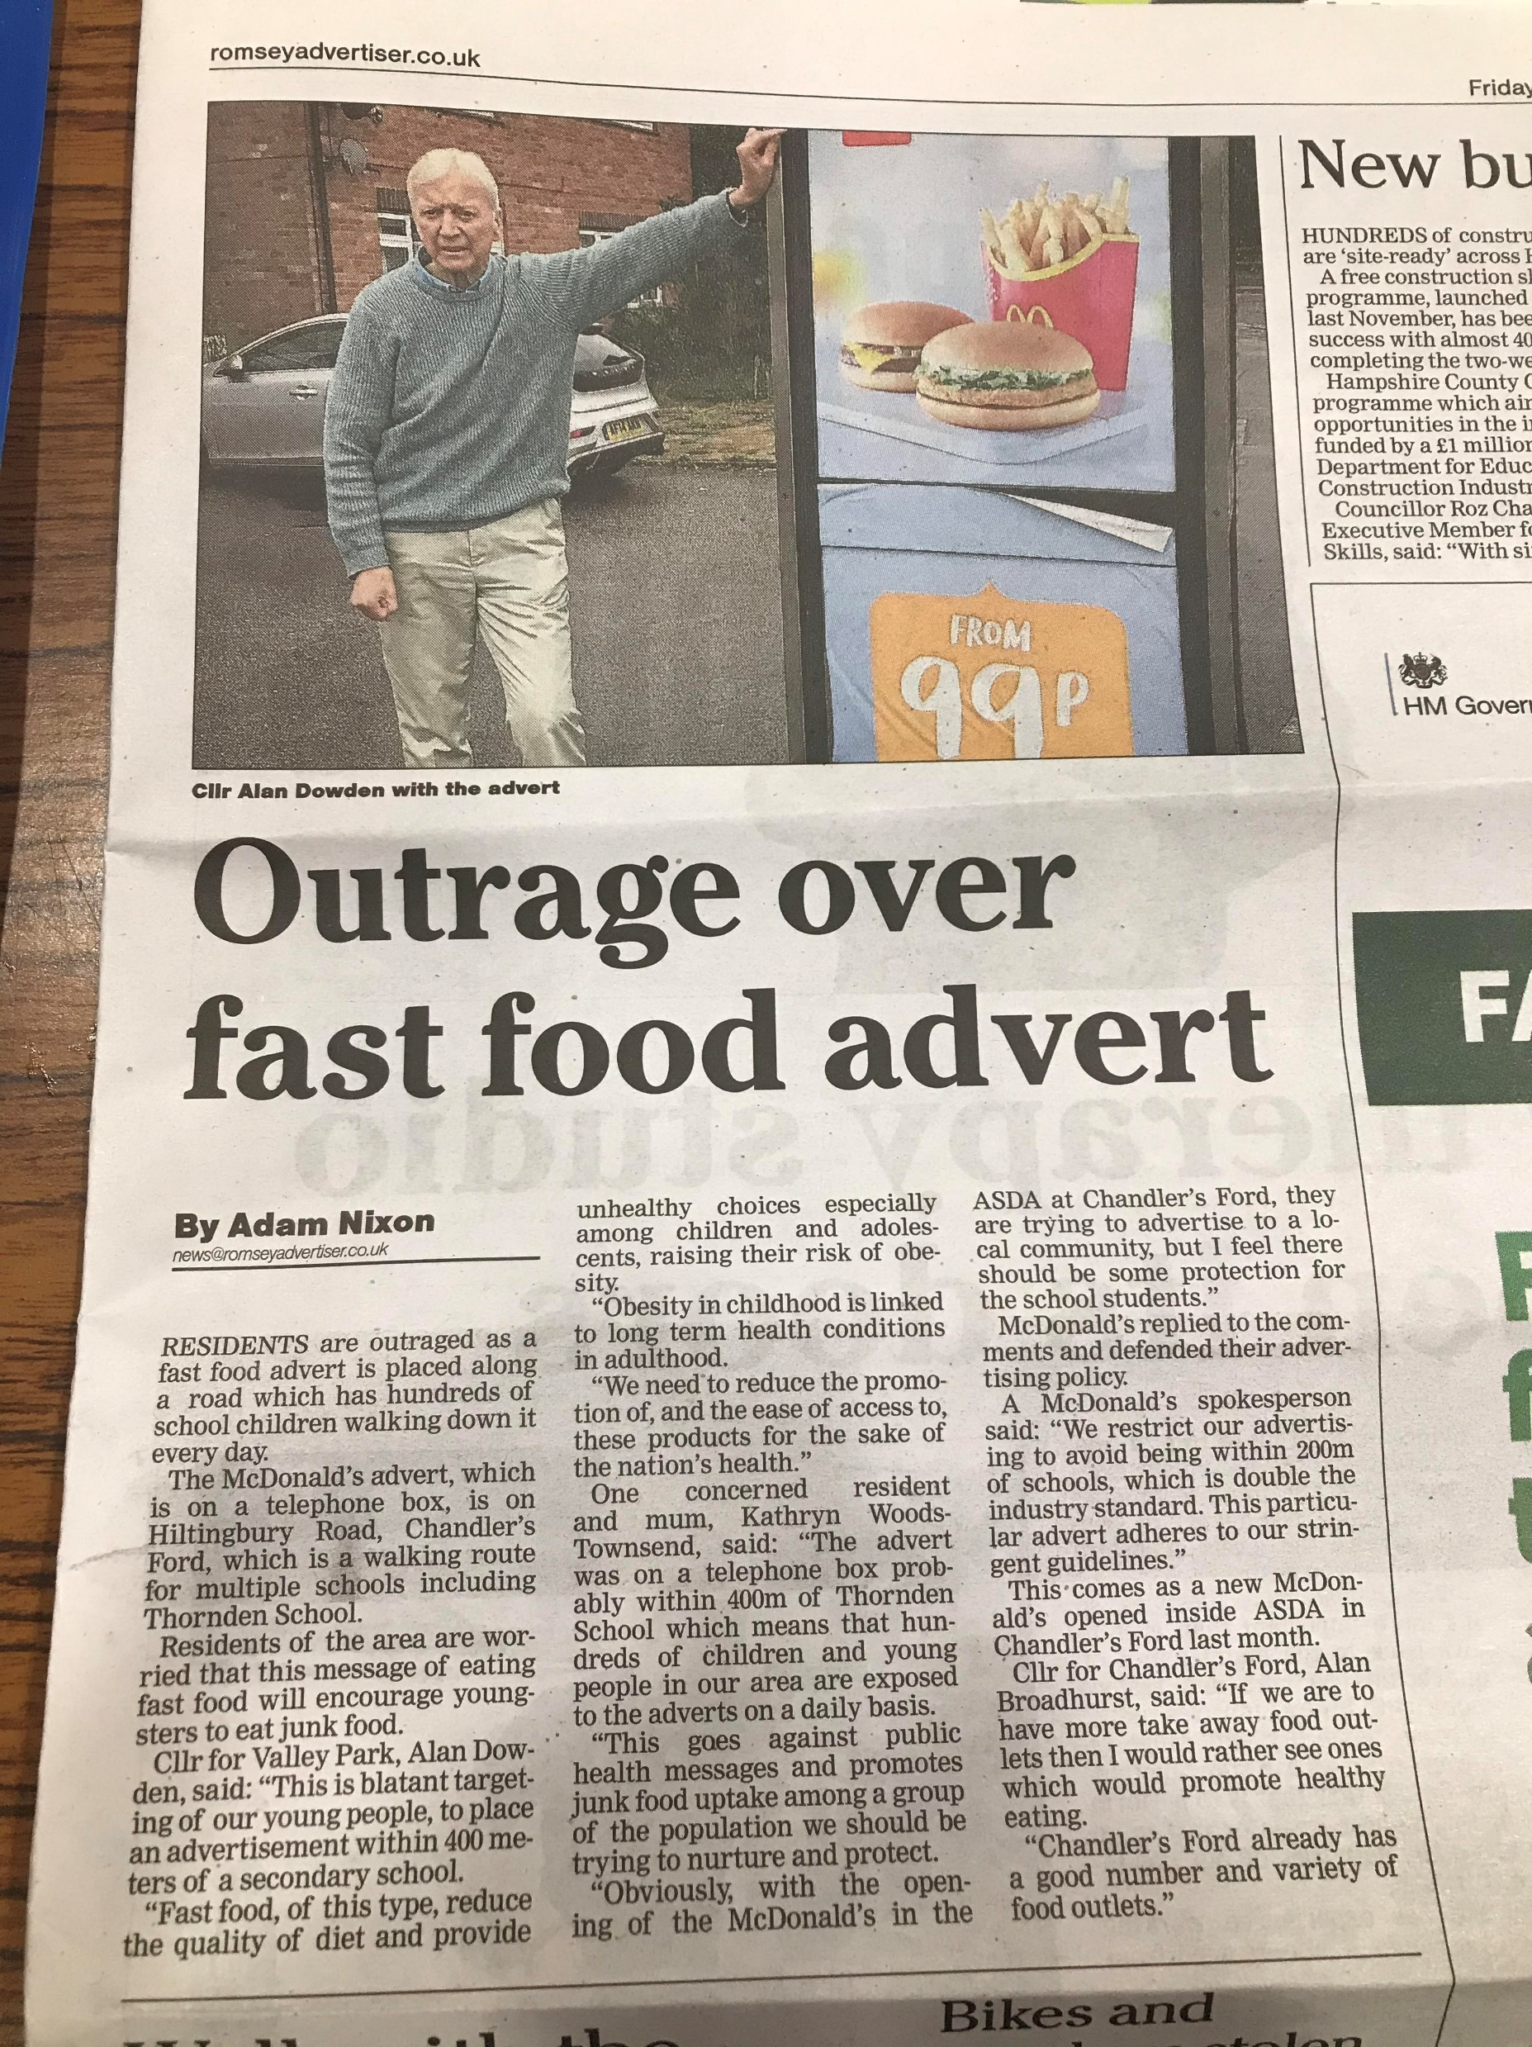
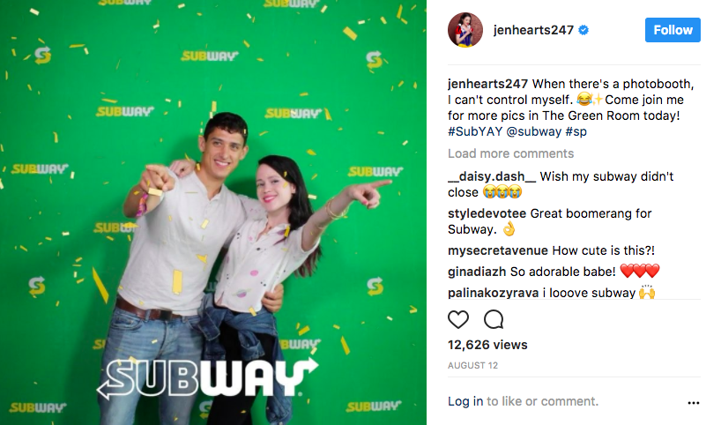
Advertising on school route
Fast food outlets, such as McDonald’s, are using phone boxes on school routes to advertise their products. Some of these let you know how close the nearest food outlet is.
Discussion point:
How often do you notice these signs? How has a product drawn you in from seeing these signs? Who do you think these advertisements are aimed at?
Celebrity Endorsement
The big brands of the fast food industry incorporate influencer marketing into their large advertising strategies. Celebrities and influencers can stand to make a lot of money from these promotions.
Discussion point:
What celebrity/influencers have you noticed promoting unhealthy food or drink types? How have you been influenced to buy a product based on celebrity endorsement?

Slide 6
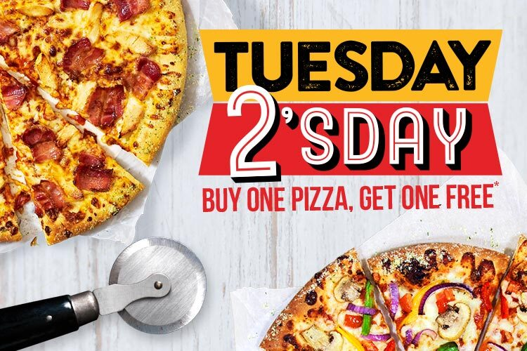
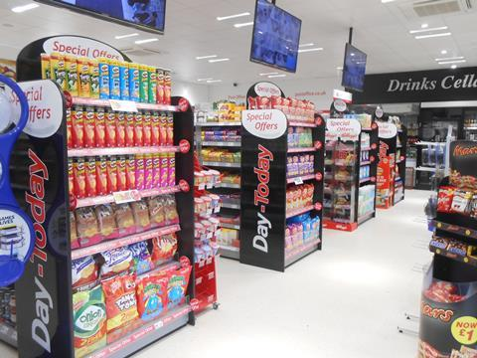
Fast food deals
These can often be posted through letterboxes or made highly visible on fast food delivery websites. They offer more food at a cheaper price.
Discussion point:
Who do you think these advertisements/promotions are aimed at?
Do you think they should be allowed to offer more food at a cheaper price?
End of supermarket aisle deals
Supermarkets place products on offer such as ‘3 for 2’ or ‘buy one get one free’ on the end of aisles in the supermarket. They are highly visible and the promotion signs are very large.
Discussion point:
Who do you think is responsible for this product placement? – Supermarkets or advertising teams for the products?
What products do you most often see promoted at the end of aisles?

Slide 7
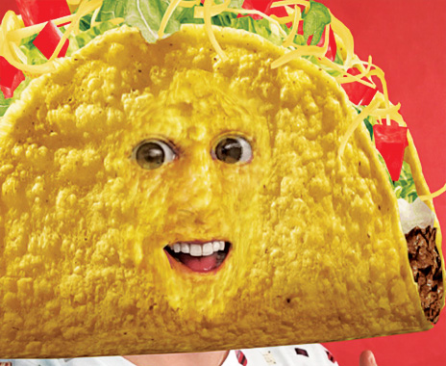
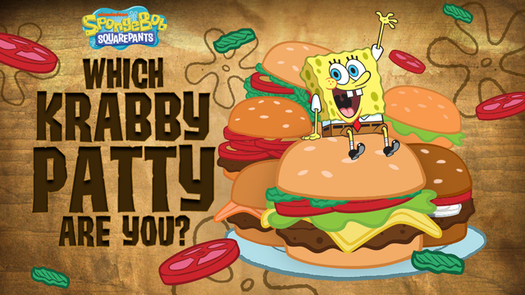
Snapchat junk food lenses
Online platforms such as Snapchat use fast food lenses. This allows users to merge their face image with a type of fast food. These are often linked to the retailer of the fast food and large advertising deals.
Discussion point:
How do you think this encourages people to eat the food?
Online games for children
Online games for children associated with children’s programmes and characters can often have links with fast food. The characters often seem to be promoting these foods.
Discussion point:
What sort of role model does this set for children? How do you think characters eating these foods easily influence children?

Slide 8
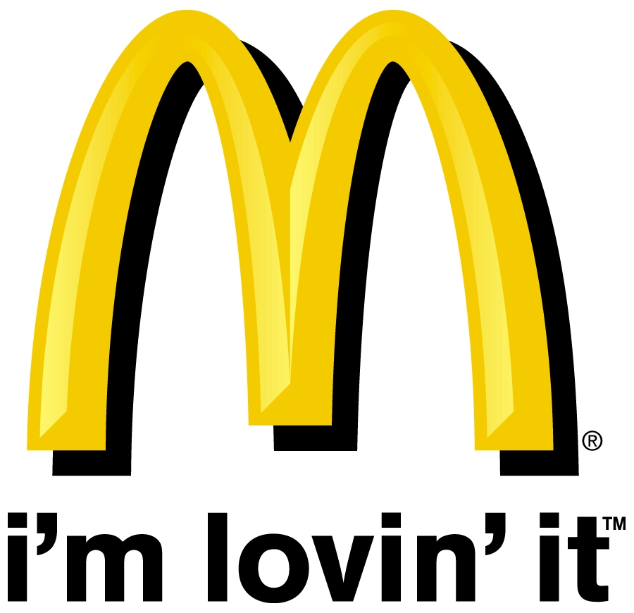

Using Jingles and Slogans
Companies often use a catchy jingle or slogan – it creates brand loyalty as you immediately associate what you see or hear with the brand. Branding is all about creating an image of your company and having that image stick in customer's minds.
Discussion Point:
What other jingles or slogans can you think of that you associate with brands you use?
Using Cartoon Characters
Products aimed at children often have cartoon or other appealing characters on their packaging to attract children. Companies rely on ‘pester power’ – that the child will be drawn to the product and pester their parent for it.
Discussion point:
How do you think parents could think these products are healthier?

