Slide 1



Module 3A: Health Detectives – Mission Digestion (Year 4)
Health Detectives ‘Mission Digestion’

Slide 2



Module 3A: Health Detectives – Mission Digestion
*If you are new the Health Warriors programme and haven’t met
the Warriors yet - watch this short
Meet the Warriors
video.

Slide 3

Module 3A: Health Detectives – Mission Digestion
Watch Ace introduce
“Mission Digestion”

Slide 4
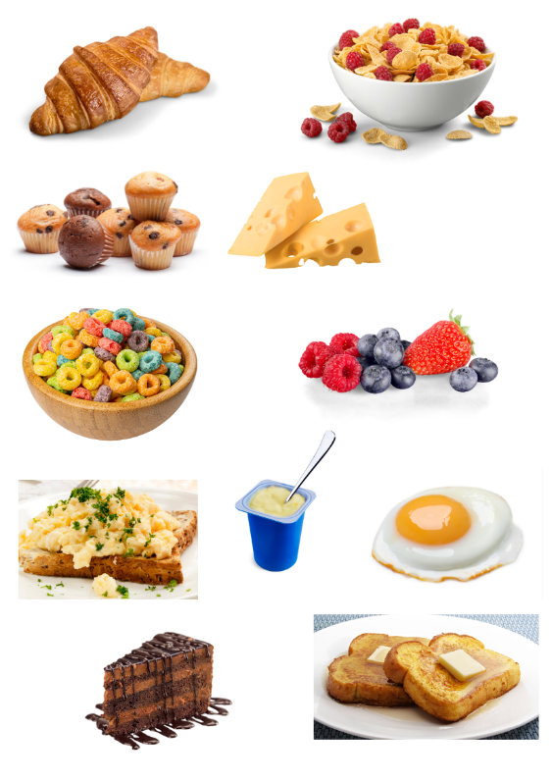
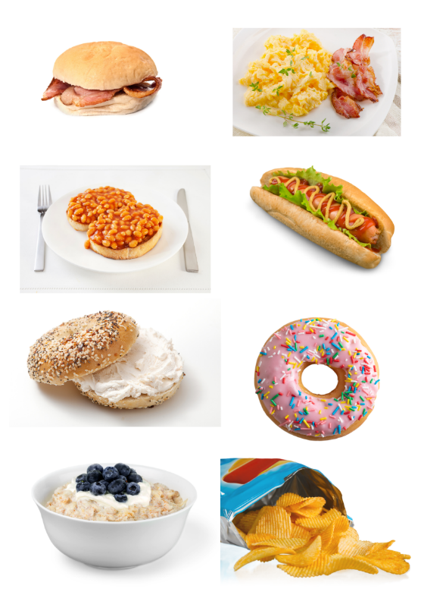
Module 3A: Health Detectives – Mission Digestion
Session 1 : A healthy way to start the day
What do you think about these breakfast choices?

Slide 5
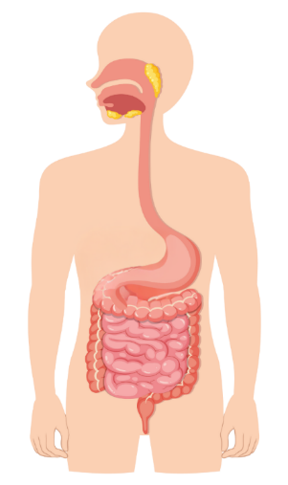
Module 3A: Health Detectives – Mission Digestion
Session 1 : A healthy way to start the day
Watch a short video about the digestive system
Click to watch

Slide 6
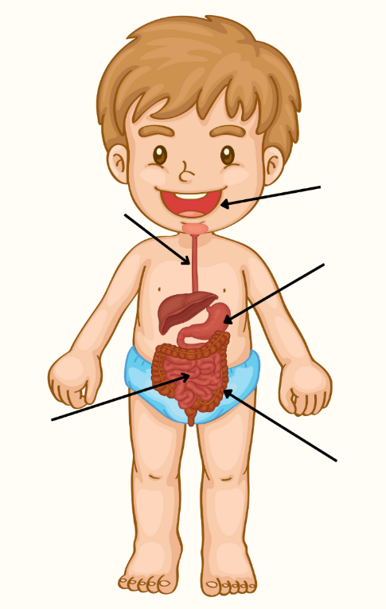
Module 3A: Health Detectives – Mission Digestion
Session 1 : A healthy way to start the day
The digestive system – organs and their functions
Can you name these organs?
Click to see the names of organs and their functions on the next slide

Slide 7
Module 3A: Health Detectives – Mission Digestion
Session 1 : A healthy way to start the day
The digestive system – organs and their functions
Click to reveal the
name and function of the organ
oesophagus
Oesophagus
A thin tube connecting
the mouth and the stomach.

Slide 8
Module 3A: Health Detectives – Mission Digestion
Session 1 : A healthy way to start the day
The digestive system – organs and their functions
Click to reveal the
name and function of the organ
mouth
Mouth
Food is broken down by teeth, mixed with saliva
and swallowed.

Slide 9
Module 3A: Health Detectives – Mission Digestion
Session 1 : A healthy way to start the day
The digestive system – organs and their functions
Click to reveal the
name and function of the organ
stomach
Stomach
Food is churned up
and mixed with stomach acid.

Slide 10
Module 3A: Health Detectives – Mission Digestion
Session 1 : A healthy way to start the day
The digestive system – organs and their functions
Click to reveal the
name and function of the organ
Small intestine
Food is broken down and nutrients are absorbed into the blood.
small intestine

Slide 11
Module 3A: Health Detectives – Mission Digestion
Session 1 : A healthy way to start the day
The digestive system – organs and their functions
Click to reveal the
name and function of the organ
Large intestine
Water from food and drink is absorbed into the blood.
large intestine

Slide 12
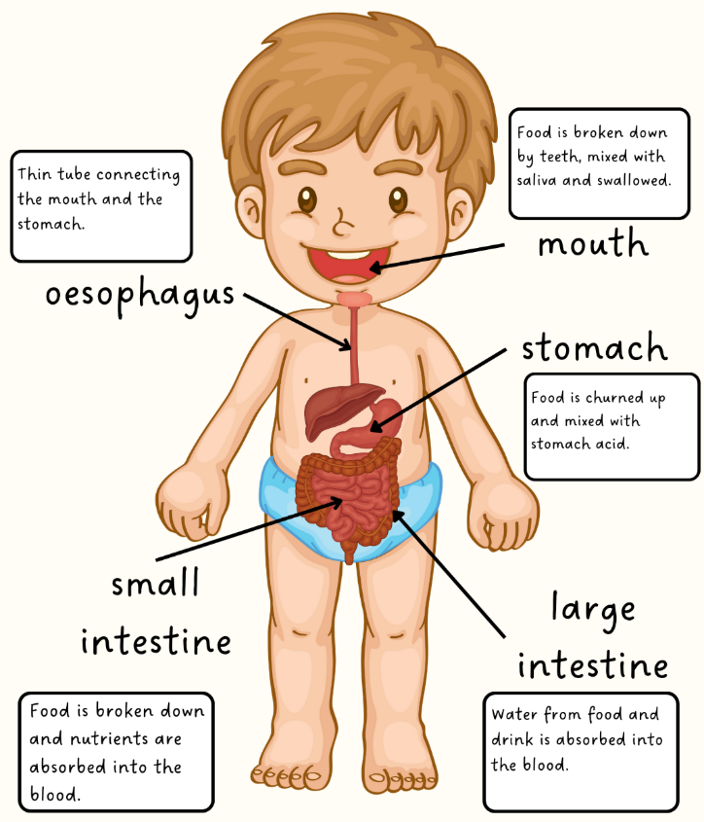
Module 3A: Health Detectives – Mission Digestion
Session 1 : A healthy way to start the day
The digestive system – organs and their functions

Slide 13
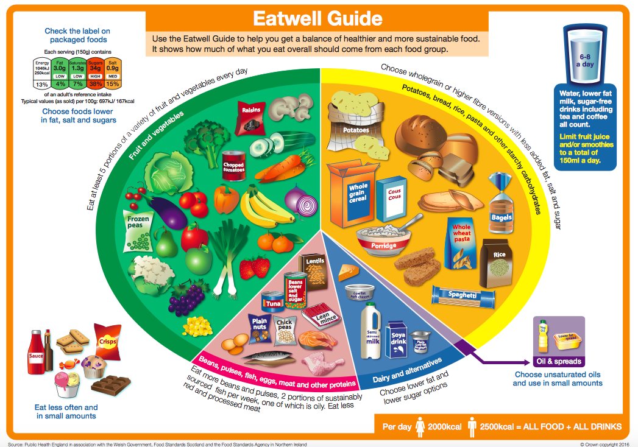
Module 3A: Health Detectives – Mission Digestion
Session 1 : A healthy way to start the day
Recap…visit the NHS website to revise the Eatwell Guide

Slide 14
Module 3A: Health Detectives – Mission Digestion
Session 2 : The Power of Veg
Session 2
The Power
of Veg

Slide 15
Module 3A: Health Detectives – Mission Digestion
Session 2 : The power of veg
Which food groups provide sources of fibre?

Slide 16
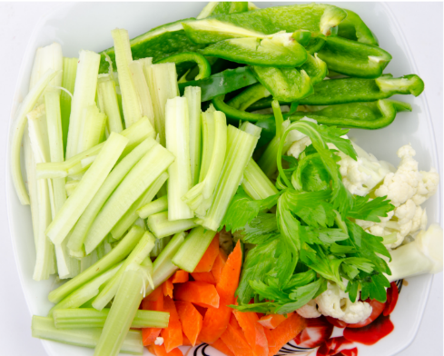
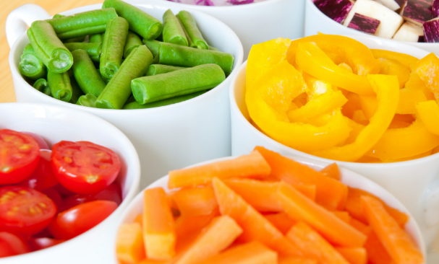
Module 3A: Health Detectives – Mission Digestion
Session 2 : The Power of Veg
How do you like your veg?

Slide 17
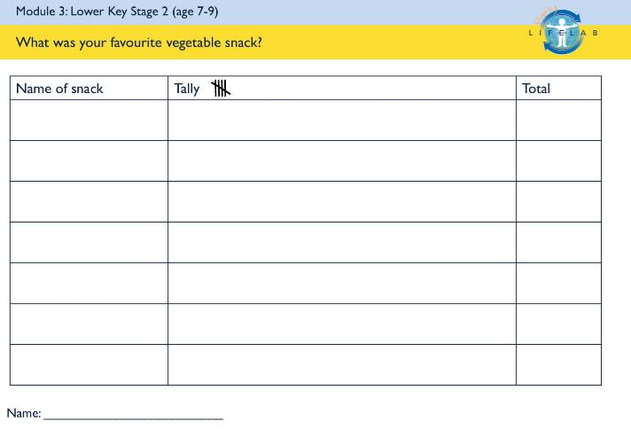
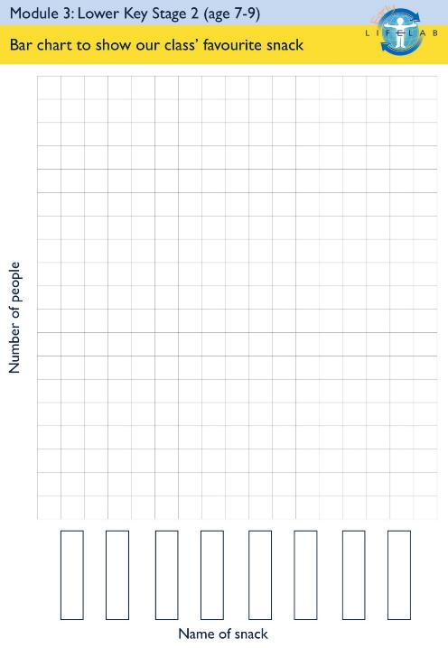
Module 3A: Health Detectives – Mission Digestion
Session 2 : The Power of Veg
Health Detectives Challenge
How do you like your veg?
Collect data on each person’s favourite vegetable snack and present as a bar chart.

Slide 18

Module 3A: Health Detectives – Mission Digestion
Session 3 : Health Warrior Promise
Watch
Health Warrior Promise
video.

Slide 19

Module 3A: Health Detectives – Mission Digestion
Session 3 : Health Warrior Promise
What small change could you make?
I will try a new vegetable every week.
I will eat a piece of fruit at playtime twice a week.
I will swap my can of coke for sugar free squash once a week.
I will swap a sugary cereal for porridge with fruit twice per week.
I will swap a sweet treat for a piece of fruit once per week.
These are some examples, but think carefully about what is important to you.

