Slide 1









What is research?
STARTER ACTIVITY
So that we all get to learn each other’s names, write your name like this in the notes section of your NxtGen workbook:
B
E
N
Write down an interesting fact about yourself per initial of your name. E.g., “B = Berlin, a city I really enjoyed travelling to”.
Share with the people on your table once you’ve finished and prepare to share with the whole group.
Session 2
Supported by
Notes:
Welcome back for Session 2 of the NxtGen Researcher Programme. Today is all about exploring the role of research in society, what we hope to learn and achieve and start to design our research project questions.

Slide 2





Starter activity 2: The Common Three Game
You have been divided into 3 teams.
In each of your teams, you have 5 minutes to discuss your interests and find 3 things you have in common.
You could explore topics such as:
A favourite holiday
A favourite hobby
Growing up in the same area
The same favourite colour
What is your team’s commonality?
Notes:
In this activity, we’ll get to know each other some more by discussing our interests.
You will be divided into 3 teams.
Each time will have 5 minutes to discuss each member’s interests and other facts about them, and then you will look to find 3 things that each member of the team have in common.
Examples of topics could be: a favourite holiday, a favorite hobby, where you grew up growing up or a favourite colour.
After 5 minutes, each team will share, with the whole group, the commonalities between them.

Slide 3



Learning outcomes
LO1: Describe what research is and why it is important.
LO2: Discuss aspirations for the future, considering challenges and opportunities.
LO3: Devise own appropriate research question.
Notes:
The learning outcomes for today’s session are:
Describe what research is and why it is important.
Discuss aspirations for the future, considering challenges and opportunities.
Devise your own appropriate research question.

Slide 4






Activity 1: What does your future look like?
Scan the Mentimeter QR code and contribute your answer!
Insert QR code / Mentimeter link with the title: "Name one future aspiration you have for yourself.
Notes:
[Notes for trainer: Create a poll on Mentimeter and then create a QR code or UR link for researchers to use and join. If you cannot use Mentimeter, there is a non-digital form of this activity on Slide 5.]
Use your phone or tablet to scan the QR code to access and join the Mentimeter page for this activity. When you get to the page, answer the question, “Name one future aspiration you have for yourself.” This doesn’t just have to be about school or work, it could be a personal goal, or even something you’re working on with other people.
In 5 minutes, we will come together, to see what words we have as a whole group.

Slide 5







Activity 1: What does your future look like?
Name one future aspiration you have for yourself.
Write it on a post-it note and stick it up on the wall.
Notes:
[Notes for trainer: Use this slide if you don’t have access to Mentimeter or researchers do not have devices/internet access]
Take a post-it note and write an answer to the question, “Name one future aspiration you have for yourself.” This doesn’t just have to be about school or work, it could be a personal goal, or even something you’re working on with other people.
In 5 minutes, we will come together, to see what responses we have as a whole group.

Slide 6
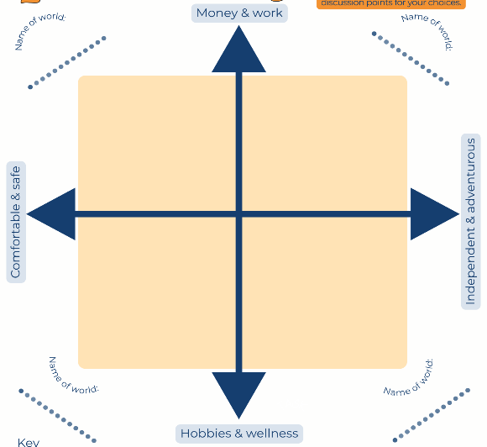




Activity 2: Futures Grid
STABLE WORLD
PRIORITISING LIFE WORLD
ENTREPRENEURIAL AND MONEY-MAKING WORLD
‘FULFILLING LIFE’ WORLD
Notes:
This next activity is an exercise called ‘Plausible Futures’.
This is an exercise that was originally developed as a strategic planning tool to support discussions with communities in low- and middle-income countries.
Its purpose is to stimulate discussions about how to allocate limited resources effectively.
We’re using it, to get us thinking about our futures, or the futures we want to see for our communities.
It starts with creating two axes which represent different approaches to life or decision-making.
These axes, when combined, create a grid with four quadrants [click for image to appear]
The four quadrants formed by the axes represent distinct "possible worlds" or future scenarios.
Work together to decide where each of the ‘worlds’ on the post-it notes should go on the grid.

Slide 7

Notes:
We are now going to take a 15-minute break. Feel free to go for a short walk, get a drink or catch-up some more with other members of the group.

Slide 8
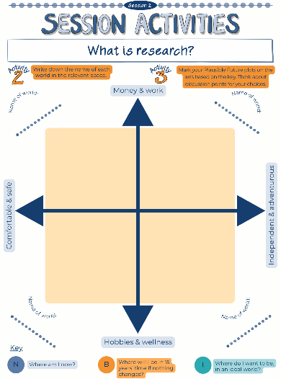

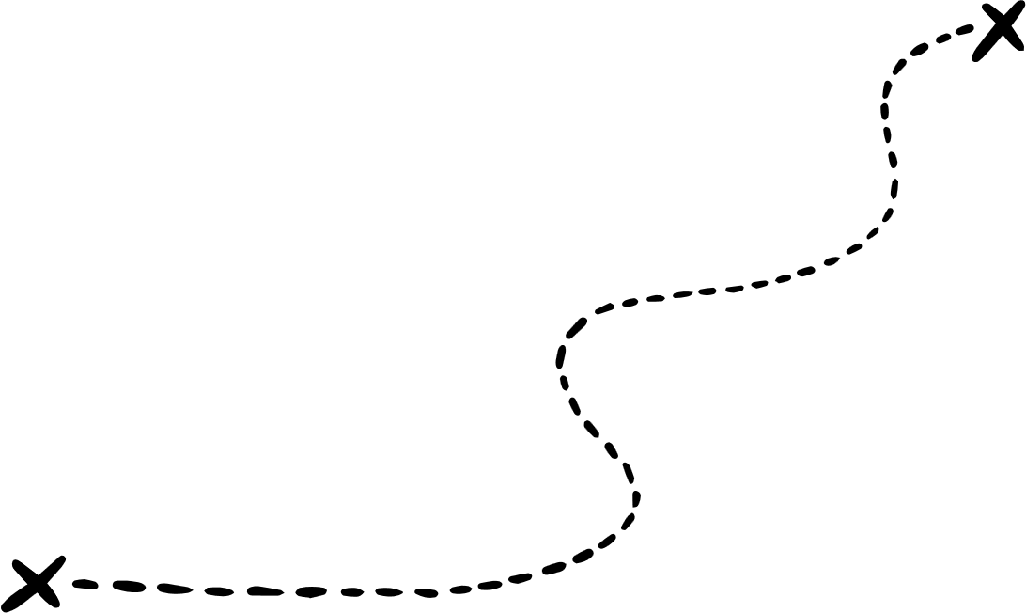

Activity 3: What does YOUR future look like?
Now, we need to plot – choose a coloured pen and plot …
1. Where you think you are now (use an ‘N’ and your initials).
2. Where you think you will be in 15 years' time if nothing changes (use a ‘B’ and your initials). B stands for ‘Business as usual’
3. Where you would like to be in an ideal world (use an ‘I’ and your initials).
Notes:
[Notes for trainer: Researchers should use a different coloured pen and plot the following on to the grid with their initials. Pause at each stage to discuss. Use a large piece of paper to draw the grid, on which the researchers will then plot their life trajectories. You may want one large grid for the whole group, or multiple copies for smaller groups.]
We are now going to plot our own lives on the grids in front of you, and track which paths we might follow.
The first point to plot is where are you now? Which attributes on the grid are you currently leaning the most words. Plot a capital ‘N’ at that point, as well as your initials.
Next, find the point that best represents where you expect to be in 15 years time if nothing changes. Plot a capital ‘B’ at that point, again with your initials.
Finally, find the point that shows here you would like to be in an ideal world. Plot a capital ‘I’ at that point, and your initials.
Join the points up, to show the path you would follow to get to where you would like to be later in life.
Discuss, as a group about barriers and opportunities that are present. What is stopping you getting to where you want to be, what needs to change to enable that to happen?
[Notes to trainer: Possible ideas that could be mentioned - health / mental health / lack of or presence of training opportunities / location of opportunities / finances / vision / having contacts or lack of contacts or role models / mindset / peer pressure / exam pressures / internet & online training opportunities / developing skills. Finish with the importance of skills to help you get where you want to be e.g. the NxtGen Programme!]

Slide 9
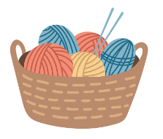

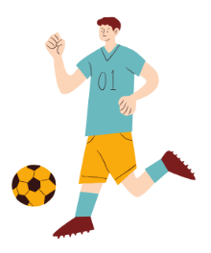


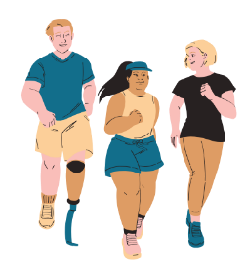

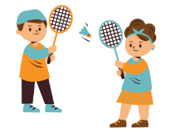
Activity 4: Choosing your research question
What subjects and themes interest you?
Thought-shower using post it notes!
Notes:
Keeping in mind that discussion we’ve just had, we now need to think about what you are going to research.
Your self-directed tasks this week will be focused on you choosing your research topic and defining your research question.
Let’s start of by thinking about what broad topics you’re interested in – have a chat in your groups and write down any themes that are of interest to you.
We will come back together, as a whole group, in 7 minutes, before sharing some of those topics together.
[Notes to trainer: Share on a whiteboard or by just sharing them out loud. Some examples are given on this slide too.]

Slide 10

Choosing your research question
EXAMPLE
Theme
Is there a theme within that subject that interests you?
Context
Who / where could you investigate?
Topic
Can you narrow down even more?
Subject
What overall subject are you interested in?
Vaping
Dangers of vaping
Young people
What are the harmful effects of vaping on teenagers?
Possible research questions
Notes:
When we’re coming up with research questions, we have to frame them in a way which means they can be answered effectively.
They have to be specific and at the same time broad enough to have interest to others.
We can use a framework like the one on this slide to start us off, and this is what you will be doing in your self-directed tasks.
To give an example, the overall subject might be something like ‘Vaping’ [click]
Then, within that, we might be interested in the dangers of vaping [click]
But the specific context might be to consider that for young people – we know that vaping is safer than smoking, so for adults using vaping to quit smoking it’s a great tool, but what does it mean for young people? [click]
And so our specific question within this broad topic could be ‘What are the harmful effects of vaping on teenagers?’ [click]
This is how we can narrow down from a broad topic to some more detailed possible research questions.

Slide 11







P.I.C.O.
Comparison:
HOW does the group’s experience of this problem compare with other people?
Outcomes:
HOW would people's experiences change if we answered this question?
Population:
WHO are you asking this question about? Which group of people?
Intervention:
WHAT is the specific issue or problem that you're interested in researching?
PICO
Notes:
We have another acronym to help us frame our research questions – P.I.C.O. [click]
‘P’ stands for population – who are you asking this question about? [click]
‘I’ is for intervention – what is the specific issue or problem you are looking at or evaluating? [click]
‘C’ is for comparison – who are you comparing against, how are you adding in some robustness? [click]
‘O’ stands for outcomes – how would people’s experiences change if we answered this question? [click]

Slide 12



P.I.C.O.
EXAMPLE 1
O
P
What is the impact on the prevalence of disease in young children of taking
Vitamin C supplements, when compared to no supplements?
I
C
EXAMPLE 2
P
O
I
What impact on teenagers’ self-confidence does participating in sport have?
Notes:
Not all questions have every element: very often questions won’t have a comparison, especially in qualitative work.
Take a look at Example 1, which says, ‘What is the impact on the prevalence of disease in young children of taking Vitamin C supplements, when compared to no supplements?
Our Population, in this example, are the young children. [click]
Vitamin C supplements is the Intervention, as they are the specific aspect that we are interested in. [click]
The Comparison is going to be made again young children who have not taken Vitamin C supplements. [click]
And, the Outcome is the prevalence of disease, as this is the change we are monitoring, in response to the use of Vitamin C supplements. [click]
However, Example 2 does not contain the same elements. The question in this example is, ‘What impact on teenagers’ self-confidence does participating in sport have?’
There are only 3 elements of PICO in this question:
Teenagers are the Population of interest. [click]
Participation in sport is the Intervention. [click]
There is no Comparison element to this question, but there the Outcome to be measured is teenage self-confidence. [click]

Slide 13




Self-directed tasks
Spend time thinking about what research you might do – discuss it with family and friends – what issues and topics are you concerned about or passionate about? Can you link your research with action that needs taking to improve your life and the lives of others in your community? Think about your overall subject and specific theme, too.
Complete the triangle and PICO worksheet to help you focus in on possible research questions.
Watch the 'Reflective and Reflexive researcher' video.
Notes:
This session’s self-directed tasks involve thinking about what research you might do.
There are 3 tasks:
The first task involves thinking about what research you might do. What issues and topics are of most interest to you. Is there an issue where you could think of solution to help not only yourself, but also your friends, family and others that live in your community?
The second task is to complete the triangle and PICO worksheets in the Session 2 section of your workbooks. These activities will help you design your possible research question.
Watch the 'reflective and reflexive researcher' video in preparation for the next session.

Slide 14


Feedback
On one post-it note per statement, please:
Tell us one thing you enjoyed today / learnt / found interesting
Tell us one thing we can improve on for next week
Name one future aspiration you have for yourself.
Write it on a post-it note and stick it up on the wall.
Notes:
Just like last session, please let us know what you think, by writing on two post-it notes.
One note for one thing you enjoyed today, found interesting or a new thing you have learned.
Another note for one thing that could be improved on for the next session.

Slide 15
With thanks and acknowledgement of the generous support and funding from:

