Slide 1
Me, My Health and My Children’s Health
Lesson 1: How Scientists Work
Notes:
The evolution of science and our role in preventing the spread of COVID-19 – YouTube

Slide 2

Objectives
At the end of this lesson, you should be able to:
  Recognise the role scientists played in the COVID-19 pandemic
  Describe how scientists conduct trials to develop new treatments
  Identify advantages of taking part in scientific research

Slide 3

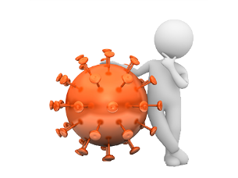
This isn’t new Science!
Check out this clip from the film Contagion in 2011:
https://www.youtube.com/watch?v=Y-YNzNOFefc
‘How many of the terms do you recognise?
Could we have been better prepared?’
Notes:
Contagion clip:
General Testing - Contagion – YouTube https://www.youtube.com/watch?v=Y-YNzNOFefc (2mins 20 secs)

Slide 4
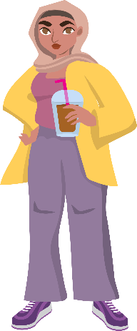
Activity 1
Where do you stand on current health issues?
‘All unhealthy food outlets should be banned within one mile of schools’
Do you agree or disagree?
Why?

Slide 5
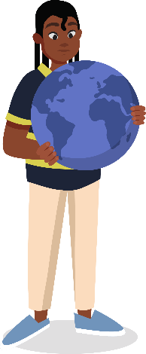
Activity 1
‘It is suggested the production of meat is causing more greenhouse gases which harm the planet. Meat eating is killing our planet.’
Do you agree or disagree?
Why?

Slide 6
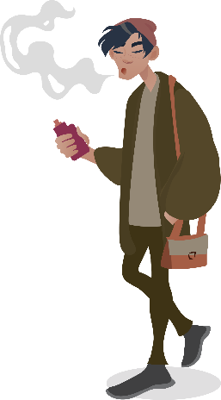
Activity 1
‘Vapes should only be available on prescription to help people who smoke cigarettes give up’
Do you agree or disagree?
Why?

Slide 7

Activity 2
How would you define health?
The World Health Organisation’s definition is:
‘Health is a state of complete physical, mental and social wellbeing and not merely the absence of disease or infirmity’
What do you think is important about this definition?

Slide 8



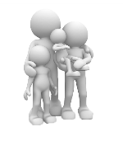
What is COVID-19?
  Coronaviruses are a group of viruses that cause illnesses ranging from the common cold to more severe respiratory diseases.
  COVID-19 is the illness caused by one particular coronavirus called SARS-CoV-2
  It is an example of a zoonotic disease; these are caused by bacteria and viruses that spread between animals and humans.
  The COVID-19 virus is highly transmissible and whilst most people who catch it have a mild illness and recover quickly some can become very ill requiring hospital treatment.
Notes:
WHO explaining how the virus has spread:
Coronavirus disease (COVID-19) – YouTube https://www.youtube.com/watch?v=i0ZabxXmH4Y (5mins 18 secs)
Slo-Mo Guys Demo why its good to wear a mask:
General Testing Slo-Mo Guys Demo – YouTube https://www.youtube.com/watch?v=KaBqrQYvBbs (3mins 55 secs)

Slide 9


Activity 3
What role did science and research play in the pandemic?
Timeline for the first 12 months of the COVID-19 pandemic:
Quarantine restrictions for travellers introduced
First vaccination given
COVID-19 identified and named
First lockdown Schools closed
COVID-19
NHS App launched
Human vaccine trials trials begin
3 Tier restrictions introduced
December 2019
First recorded death in the UK
Saliva testing trials start
December 2020
First reported cases in the UK
Occupancy of hospital critical care beds peaks
Dexamethasone treatment made available in NHS
New faster spreading variant detected
First patients show symptoms in Wuhan China
Second lockdown
WHO declares global pandemic
Test and trace started
Face coverings compulsory in shops
Notes:
Intro:
The evolution of science and our role in preventing the spread of COVID-19 – YouTube https://www.youtube.com/watch?v=Qg8sRsERlwU (1min 20secs)
&
Southampton COVID-19 research through media lens v6 – YouTube https://www.youtube.com/watch?v=NkkCUudcfLY (3mins)
Or alternative:
University of Southampton helping in the fight against COVID-19. – YouTube https://www.youtube.com/watch?v=1C9EVri-CA0
More info:
COVID-19 drug testing clinical trials | University of Southampton – YouTube https://www.youtube.com/watch?v=TbiqKsbkR_I
Personal respirator for treating covid-19 (PeRSo) | University of Southampton – YouTube https://www.youtube.com/watch?v=Gy64nyDTBzk

Slide 10
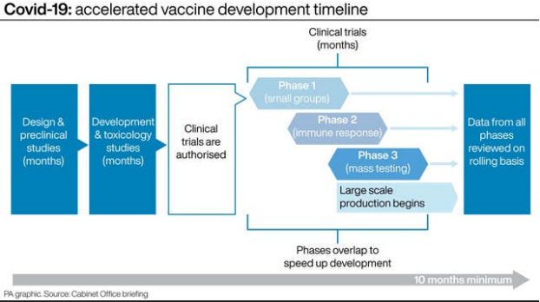
How was the COVID-19 vaccine developed so fast?
Normally developing a vaccine is a slow process, taking an average of around 10 years to completely develop a new vaccine from scratch.
Scientist had research to build on from past viral outbreaks
The unprecedented demand worldwide for a vaccine prompted funding from governments
It was a global effort, with scientists sharing information around the world
The trial phases and manufacturing overlapped
Each phase normally takes years with years in between, but the COVID-19 vaccine was developed in 10 months! Collecting as much data as any other trial, without compromising safety.
Notes:
Covid vaccine safety: How does a vaccine get approved? - BBC News https://www.bbc.co.uk/news/av/health-55281633 (2mins 53 secs)

Slide 11
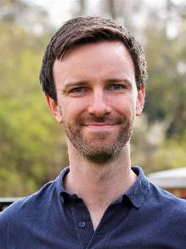
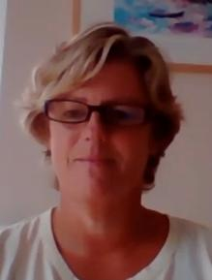
Meet two people who have been involved in developing a new vaccine for COVID-19
Dr Alasdair Munro
and Ruth…
works at Southampton General Hospital, specialising in paediatric infectious disease, including clinical trials for the COVID-19 vaccines
is a volunteer who is taking part the COVID-19 vaccines trials
Notes:
Full videos:
https://bit.ly/MtSAlasdairMunro
http://bit.ly/LifeLabC19VaccineTrialParticipant

Slide 12

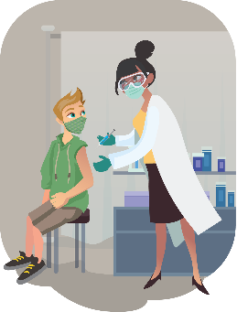
Activity 4
Vaccines and trials
All new treatments and medicines have to be tested in clinical trials.
There are strict criteria for people who want to volunteer to take part in any trial.
Look at the completed questionnaires from people who applied to take part in the vaccine trials.
Who would you to choose to take part and why?
Notes:
BBC Horizon clip on how vaccines can help protect communities:
General Testing - BBC Horizon - Vaccine – YouTube https://www.youtube.com/watch?v=uqN3r14vU4M (1min 38secs)
General Testing - Kate Glyn-Owen - Vaccines – YouTube https://www.youtube.com/watch?v=Y27WCb_k9CM (2mins 43 secs)

Slide 13
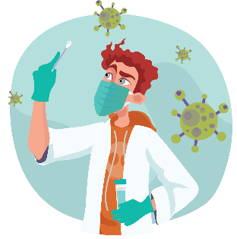
Could you take part in scientific research?
Activity 5
Most people engage with scientific research through news headlines, social media and some patients through clinical trials.
This is called PPI (Patient and Public Involvement)
How do you think the views of young people could help the research being carried out?
How could young people benefit from taking part?
What may put young people off from taking part?

Slide 14
Homework task
Ready for next lesson:
  Take a photograph or write down everything you eat and drink in one day, including all the snacks!

Slide 15

Objectives
At the end of this lesson, you should be able to:
  Recognise the role scientists played in the pandemic
  Describe how scientists conduct trials to develop new treatments
  Identify advantages of taking part in scientific research

Slide 16

Reflection
What new things have you learnt today?
How well did you understand today’s material?
What skills have you used today?
What will you make sure you remember from today?

Slide 17
This work is funded by the Department of Health and Social Care (DHSC) and the National Institute for Health Research (NIHR). The views expressed are those of the authors and not necessarily those of DHSC or NIHR

