Slide 1
Me, My Health and My Children’s Health
Lesson 3: What are the Health Risks?

Slide 2

Objectives
At the end of this lesson, you should be able to:
  Determine possible risks to our health
  Suggest how different factors might influence an individual’s health
  Work collaboratively to carry out research on a non-communicable disease

Slide 3
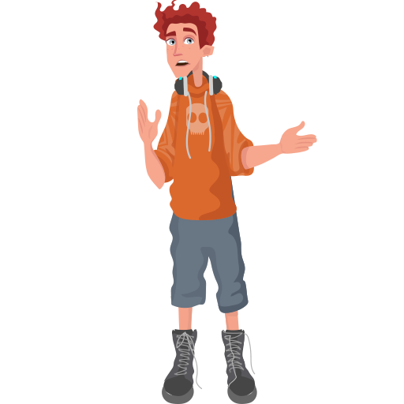
What do you think people are most likely to die from in the UK?
Notes:
THIS LESSON COVERS SOME SENSITIVE ISSUES AND YOU MAY WANT TO DISCUSS THESE WITH STUDENTS AT THE START.
Hook: Class discussion around factors that could contribute to a person’s death. Do they think any factors could have more of a contribution than others? (NHS Atlas of Risk image).

Slide 4
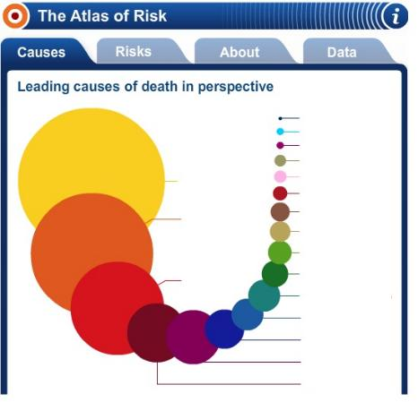

Causes of Death
What do you think people are most likely to die from in the UK?
Notes:
THIS LESSON COVERS SOME SENSITIVE ISSUES AND YOU MAY WANT TO DISCUSS THESE WITH STUDENTS AT THE START.
Hook: Class discussion around factors that could contribute to a person’s death. Do they think any factors could have more of a contribution than others? (NHS Atlas of Risk image).

Slide 5


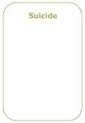
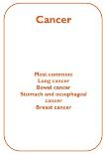
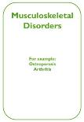

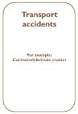
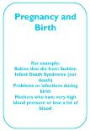

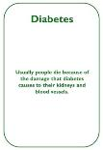
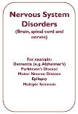
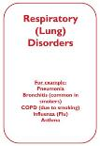

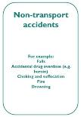
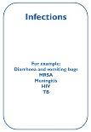
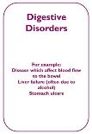

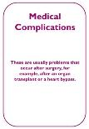
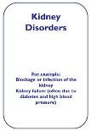
Activity 1
Can you identify the top 3 causes of death?
What are the least common?
Notes:
Activity 1: Can you rank the causes of death?
Using the ‘cause of death’ cards from the lesson resources pack, students should work in pairs or small groups to identify the top 3 most common and least common causes of death in the UK as well as the least common cause of death in the UK. Can they justify their decision? They should the compare their choice of cards to the correct graphic (see next slide).

Slide 6
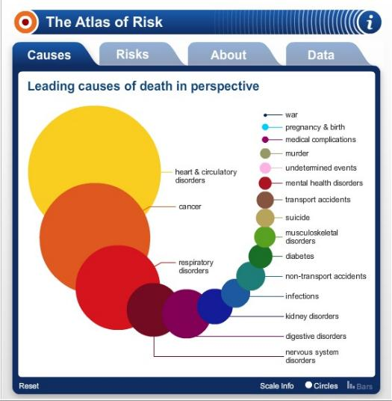
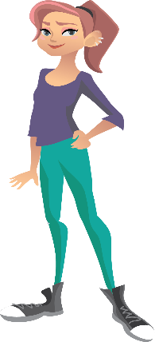
Activity 1
Were you correct?
Are you surprised by any?
Notes:
Activity 1: With students looking at their identified top 3 most and least common causes of death, they can now compare it against the actual order. How did you compare to the actual causes of death in the UK? Are you surprised? (E.g. age is missing from the cause of death cards as this is not medically classified as a cause of death). Student should the correct ones in their table.

Slide 7

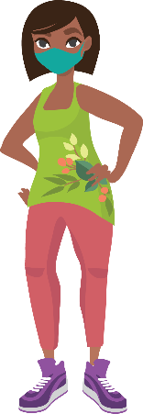
What impact do you think COVID-19 has had on the causes of death?
Activity 1

Slide 8

Activity 2
Can you now sort the causes into three groups?
Notes:
Activity 2: How could you sort the cards?
Students decide how to classify their cards into groups. Students share their ideas justifying how they have classified their cards. ‘What are your reasons for having put them into those groups? Highlight the differences between communicable diseases and non-communicable diseases – record the classifications in their books and the re-sort the cards into three groups. Key point: NCDs are by far the most common cause of death in this country and are directly linked to lifestyle choices. Students should list three NCDs directly linked to lifestyle choices. What category do the three most common causes of death fit into?

Slide 9
Activity 2
Notes:
Activity 2: How could you sort the cards?
Students decide how to classify their cards into groups. Students share their ideas justifying how they have classified their cards. ‘What are your reasons for having put them into those groups? Highlight the differences between communicable diseases and non-communicable diseases – record the classifications in their books and the re-sort the cards into three groups. Key point: NCDs are by far the most common cause of death in this country and are directly linked to lifestyle choices. Students should list three NCDs directly linked to lifestyle choices. What category do the three most common causes of death fit into?

Slide 10

Activity 3
How do you think the main causes of death have changed over time?
Notes:
Activity 3: How has this changed over time?
How do you think the main causes of death have changed over time? Would they be in the same order if we went back in history? Explain why and what has changed? Students identify three Public Health advances and suggest how these advances have contributed to improvements to public health – see teacher guide for ideas.

Slide 11






Activity 4
Non-Communicable Diseases
Group A: Type 2 Diabetes
Group B: Heart Disease
Group C: Mental Health
Group D: COPD
Group E: Cancer
Group F: Stroke
You can find links to these websites at the back of your booklet.
These organisations would be a good place to begin your research.
Notes:
Activity 4: Researching a non-communicable disease.
Working to complete the grid on p.23 of the booklet. Students should focus their research on what the disease is, who gets it, the symptoms, risk factors, treatment, prevention and lifestyle choices. There are website links in the back of the student booklet that students can use.

Slide 12
Objectives
At the end of this lesson, you should be able to:
  Determine possible risks to our health
  Suggest how different factors might influence an individual’s health
  Work collaboratively to carry out research on a non-communicable disease

Slide 13

Reflection
What new things have you learnt today?
How well did you understand today’s material?
What skills have you used today?
What skills did you find difficult today?
What will you make sure you remember from today?
Notes:
Students refer back to the lesson objectives and complete the assessment for learning activity in the orange boxes, feedback and share an interesting fact they have found out from the lesson. Remind students about the EACH-B APP.

Slide 14
This work is funded by the Department of Health and Social Care (DHSC) and the National Institute for Health Research (NIHR). The views expressed are those of the authors and not necessarily those of DHSC or NIHR

