Slide 1
Me, My Health and My Children’s Health
Lesson 4: Assessing Health

Slide 2

Objectives
At the end of this lesson, you should be able to:
  Identify risk factors that can affect our health
  Analyse evidence from different sources
  Draw conclusions from the evidence

Slide 3
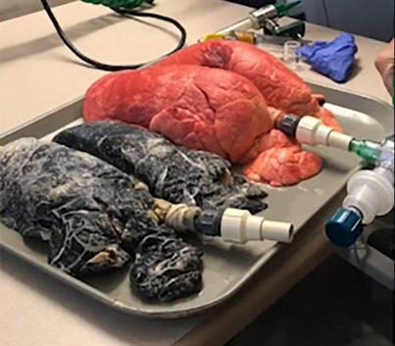
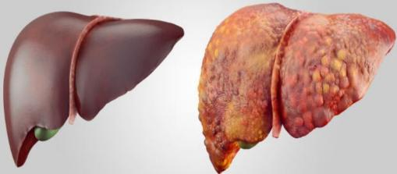
Spot the healthy ones…..
Liver
Lungs
What are the differences?
What might be the causes of these differences?
How do you think the individual's health was affected?
Notes:
Hook: Ask students to look at these before and after images of the liver and lungs. What are the differences? What do you think may have caused these differences? How do you think the individual's health was affected?

Slide 4
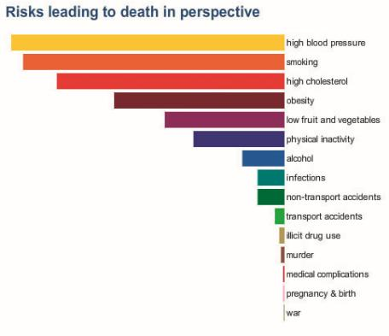
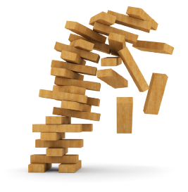
Tower of Risk
Activity 1
Remove a block from the tower and after each turn discuss the following questions in your group:
Identify your risk
How high/big is your risk compared to others?
What could it lead to?
How could you reduce this risk?
Notes:
Activity 1: Play the Tower of Risk
Discuss and clarify a definition for risk: ‘What do we mean by risk?’
Students play ‘Tower of Risk’ using the play instructions in small groups – they take it in turns to remove a block. Each turn they identify the risk they have removed to the rest of the group and discuss – how big a risk it is? What could it lead to? How could you reduce the risk? What changes could you make to your lifestyle? The player who makes the tower fall is dead and needs to inform the rest of the group which block/risk led to their cause of death.
Note that the number of blocks for each risk have been calculated so that they are in proportion to NHS statistical data on risks linked with causes of death in the UK. After playing the game ask the whole class – Which risk made the tower fall most often? Is this what you expected? Explain why?

Slide 5
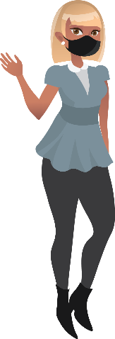
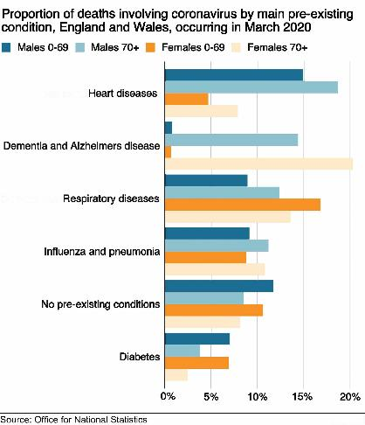
What health conditions increase the risk from COVID-19?
Activity 2
Notes:
BAME coronavirus deaths: What's the risk for ethnic minorities? - BBC News – YouTube https://www.youtube.com/watch?v=VTr29p4H4TE (2mins 15 secs)

Slide 6
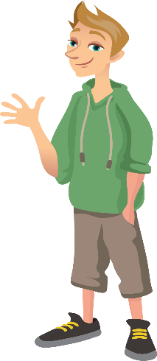
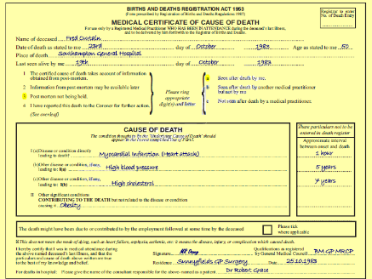
How Healthy is Chris?
How healthy am I?
How worried should I be about my health?
What changes should I make to my lifestyle?

Slide 7
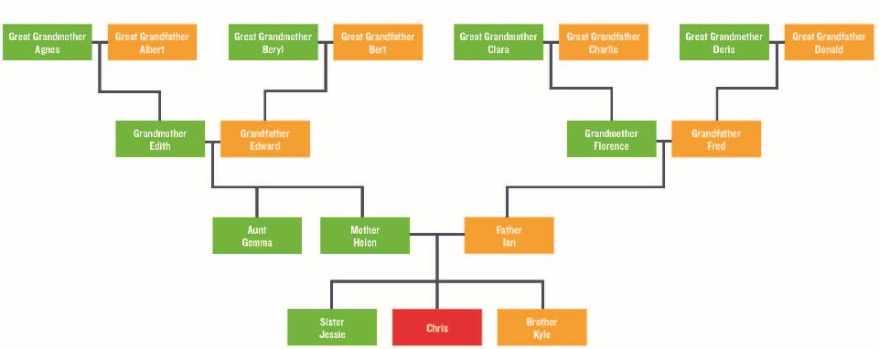



Introducing Chris and his Family
Notes:
Activity 3: Assessing Chris’s health.
A: Family background and history – family tree.

Slide 8
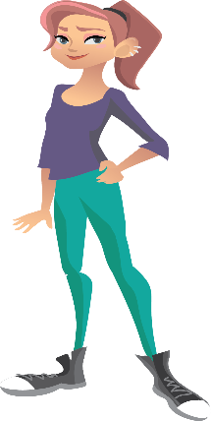
Activity 3
What are the health risks that Chris may have to face in the future?
How healthy is Chris?
What would a scientist do if they had to answer these questions?
We’re going to approach this problem like scientists do; we’ll look at all the evidence available and try to make an informed decision.
Notes:
Activity 3: Researching Chris’s health

Slide 9

Where could we get the evidence from?
Activity 3
Researching Chris’ Health
  A: Family background and history
  Sources - family tree, family medical history and set of family cards, with information about Chris’ relatives and friends
  B: Current lifestyle
  Sources - Chris’s food diary, Eatwell Guide and sleep report, Mum’s weekly shopping list and fridge photo, Transcript of Chris’s TecC-19 focus group.
  C: Early development and childhood
  Sources - Midwifery notes including mother’s lifestyle, and notes from baby book which includes growth chart birth weight, breast/bottle-feeding
Notes:
Activity 3: Researching Chris’s health

Slide 10
Activity 3
Researching Chris’ Health
For your group you need to summarise:
Which pieces of evidence are most helpful?
Why are they helpful, what does the evidence tell you?
What are the health risks Chris may face in the future?
Who in Chris’s family is most at risk from their health data?
Record your findings on the summary sheet in your booklet
Notes:
Activity 3 & 4 – completing summary grid on p. 29 as part of assessing Chris’s health and researching Chris’s health.

Slide 11
Objectives
At the end of this lesson, you should be able to:
  Identify risk factors that can affect our health
  Analyse evidence from different sources
  Draw conclusions from the evidence

Slide 12

Reflection
What new things have you learnt today?
How well did you understand today’s material?
What skills have you used today?
What skills did you find difficult today?
What will you make sure you remember from today?
Notes:
Students refer back to the lesson objectives and complete the assessment for learning activity in the orange boxes, feedback and share an interesting fact they have found out from the lesson. Remind students about the EACH-B APP.

Slide 13
This work is funded by the Department of Health and Social Care (DHSC) and the National Institute for Health Research (NIHR). The views expressed are those of the authors and not necessarily those of DHSC or NIHR

