Slide 1








The first step
STARTER ACTIVITY
Whilst we settle in, have a think about what superpower you would love to have!
Session 1
Supported by
Notes:
[Note to trainer: Play video https://bit.ly/LifeLab_NxtGen_Intro and hand out NxtGen workbooks while video plays.]
Hello, welcome to LifeLab and welcome to the NxtGen Researcher Programme. Thank you for taking the time and effort to apply for the programme and well done on your excellent applications and interviews, we're really excited to work with you over the course of the programme.
The programme consists of 16 sessions, followed by a Co-Production Assembly, which is a workshop with decision-makers to turn the recommendations you have identified from your research into action. Over the sessions, we will explore a range of topics and develop skills, all related to conducting and presenting research.
To begin with, let's get to know each other by playing bingo!

Slide 2




Starter activity 1: Find someone who…
Has green eyes | Has an unusual pet | Is doing or did A Level Psychology | Has met someone famous | Has ever walked more than 15,000 steps per day
NAME: | NAME: | NAME: | NAME: | NAME:
Says their favourite colour is blue | Has a TikTok account | Plays a musical instrument | Has been on TV | Has been to the cinema this year
NAME: | NAME: | NAME: | NAME: | NAME:
Has ever been on a zipwire | Has an unusual hobby | Read a book in the last month | Likes rain | Plays for a sports team
NAME: | NAME: | NAME: | NAME: | NAME:
Is left-handed | Has met a member of the Royal Family | Can speak more than one language | Is vegetarian | Is a dancer
NAME: | NAME: | NAME: | NAME: | NAME:
Has taken a cooking class | Has been to a music concert this year | Wears contact lenses | Has a favourite castle | Likes chocolate
NAME: | NAME: | NAME: | NAME: | NAME:
Notes:
As part of the programme, you will each have a workbook, which we will talk about some more later on.
For now, turn to page XX , where you will find the bingo activity sheet.
Try to find researchers/peers who relate to different statements. The first person to find names for each statement wins!

Slide 3






Starter activity 2: Meet the Minds
My pronouns are…
My name is…
Tell the group your name and your pronouns, then pick someone you found with an interesting bingo element, share with the group, and pass it onto them.​
Notes:
Ok, let's see how you've done with your Bingo cards.
We will go around the room, so that you can each let us know your name and preferred pronouns.
After that, please share one fact about someone that you have on your bingo card.

Slide 4


Learning outcomes
LO1: Become familiar with each other and the NxtGen Researcher space.
LO2: Access email accounts and workspaces (e.g. TEAMs).
LO3: Discuss what the NxtGen Researcher programme is and reason for participation.
Notes:
Today's objectives are:
Becoming familiar with the other researchers on the programme and the space we will predominantly be using during the programme.
Accessing your email accounts and the Microsoft TEAMS workspace.
Discussing the NxtGen researcher programme and thinking about why you want to be part of this.

Slide 5

Welcome & housekeeping
Bathrooms
Fire escapes and alarms
Quiet space
Prayer space
Food and drinks are always available
Notes:
We'll go through a few housekeeping notes, to show you:
Where the bathrooms are,
The fire exit routes,
Where you can find a quiet space if you need to take a break,
Where the prayer space is located, and
Where refreshments are kept.

Slide 6


NxtGen Trainer(s)
[Staff name]​
[Staff role]
[Staff name]​
[Staff role]
Notes:
[Note to trainer: Feel free to add more/fewer facilitators/staff members if needed.]
XX and myself will be running the NxtGen Researcher Programme with you over the next few months.

Slide 7

Starter activity 3: Gives, gets & grounds
Let’s discuss what our “Gives, Gets and Grounds” should be.
Notes:
This first group activity is a chance for us to discuss how we might expect to work with and treat each other. It also is an opportunity to talk about what you would each like to get from this programme and what you'd like to share with us.
We would like you to write on sticky notes items that you would like to go in our Gives, Gets, Grounds.
Gives are things that you would like us to give you. That could be anything, like specific skills, particular conditions of the working environment, or even a specific food or drink.
Gets are things that we would get from you. What would you like to give back to us? That might be sharing your perspectives on community matters, recommendations for policy change through your research, or simply a new joke to share with the group each session!
Grounds are the expectations we have for us to all achieve the Gives and Gets we have suggested. They are the ground rules for us to create and maintain a safe and engaging space throughout the programme and beyond. What are important ground rules for you? How can we make this space accessible and inclusive for everyone?
[Notes for trainer:
Starts some discussions while researchers are writing their notes. Include some of your own suggestions, to ensure some of your own desirable gives, gets, grounds. (e.g. Be respectful of other people’s opinions, Listen, Be on time, shared contribution, confidentiality – respect people’s privacy).]

Slide 8






Starter activity 3: Gives, gets & grounds
Ask questions – don’t worry about anything or anyone
Be on time
Be respectful
Collaborate with the group
Let’s discuss what our Gives, Gets and Grounds should be.
Complete self-directed tasks
Post it feedback – and we’ll listen and action!
Contribute to the discussions
Listen
Notes:
Here are a few examples of grounds that we think could help create a safe and collaborative space for everyone. What do you think about them?
Be respectful of other people’s opinions – this is one of privileges of this programme, hearing all sorts of opinions. So, no-one should feel they can’t share, and we should all respect that we may have different opinions.
Be on time – we have lots to get through, so please try to be on time. If you’re going to be late, or you can’t come one session, then please let us know.
Ask questions – this is really important. It’s really important anyway, as we want to encourage you to be involved, but also, when you start your data collection and you are ‘out there’ in the world talking to people, then we really want to know if there is anything of any concern to you. Also, if you’re worried about someone else – please let us know. We are always learning with this programme, and we can only learn through hearing from you.
Collaborate with the group – you’ll get more out of each session if we’re all working together.
Post-it notes – this is as much about us making a commitment to you as well – we’ll ask for feedback for every session and will try to put suggestions into action.
Listen – goes back to being respectful – listen to each other, allow everyone the chance to share their thoughts and opinions. This research programme is about finding out new things, so there aren’t ‘right’ and ‘wrong’ answers, so we all need to listen and learn from each other.
Contribute to the discussions – again – the more you put in, the more you and everyone else will get out of it
Self-directed tasks – as you know there are some tasks for you to complete between sessions – sometimes not much, but when you’re doing data collection and analysis, it’s more. Please try to keep on top of the tasks – but again, please just chat to us if you have any challenges, we want this to be a programme that is enjoyable and manageable for everyone
Please respect people’s privacy and keep what is said in the sessions confidential – don’t share personal information outside of these sessions

Slide 9
Important logistical information
[If applicable] Timesheet - Each month we will complete a timesheet for you (on your behalf), with the number of hours you have completed (two hours for our in-person training session, plus two hours each week for your self-directed tasks).
[If applicable] Payment – You will get paid one month in arrears, which means that, for example: the work you do in December you’ll get paid for at the end of January.
[If applicable] TEAMs site (or similar) - Access to our TEAMs site will be via your [name of institution] email address.
[If applicable] Self-directed tasks - If you don’t complete and submit your self-directed tasks, you will not get paid. Tasks can be emailed to us or uploaded to your TEAMs channel.
Communication - Make sure you communicate with us, checking your emails often and let us know if you have any problems or don’t understand anything. We are here & happy to help!
Notes:
[Notes for trainer: Please delete and use whichever parts of this slide will apply to how you are running the programme. The script below accommodates all logistical aspects of the programme when run by LifeLab.]
We'll go through details of a few logistical aspects of the programme.
We will complete timesheets for each of you, which will be completed each month. The timesheets will incorporate 2 hours each week for the in-person sessions and 2 hours each week for the self-directed tasks and other workbook activities for that week.
You will be paid one month in arrears, which means the work you do in one month is paid for at the end of the next month. For example, December's timesheet will be paid at the end of the January.
You will have a folder on Microsoft Teams channel, where you will need to save your work and upload completed workbook entries each week. You can access the TEAMs site by logging in with the university email address that was set up for you earlier.
In order to get paid, you will need to complete the self-directed tasks each week. Therefore, it is important that you complete the work each week and upload it to your TEAMs folder. If you are having problems with uploading, you can also email us your work.
It is important that you maintain regular communication with us. Please check your university email often and let us know if you have any issues or need help understanding something. We are here to support you throughout the entire programme.

Slide 10

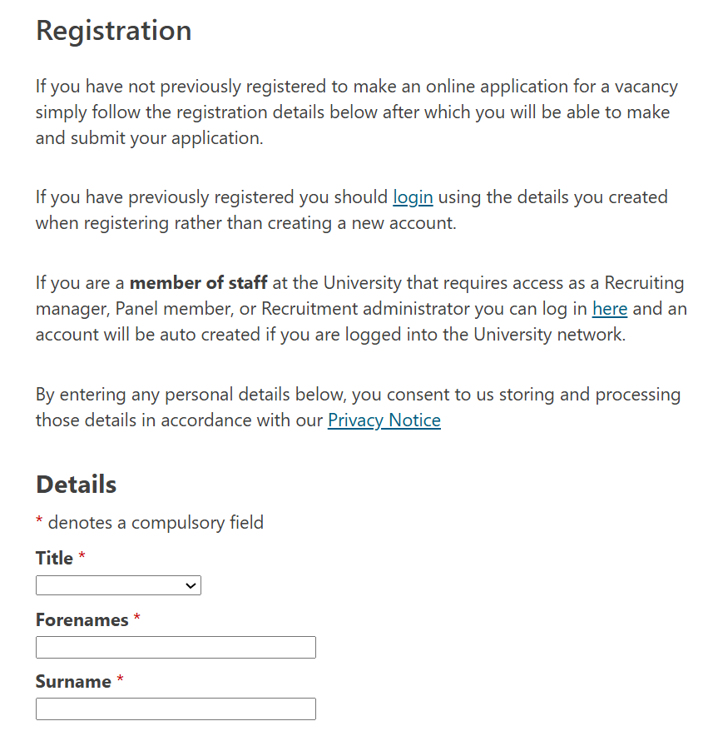
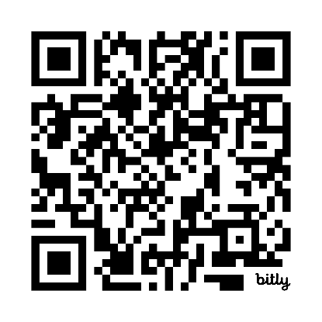
Register with UniWorkforce
https://jobs.soton.ac.uk/Registration/
Notes:
To make sure we can submit a timesheet for you, and so you can get paid, you will need to have registered with UniWorkforce. If you haven't yet done this, use the QR code to go to the registration webpage.

Slide 11
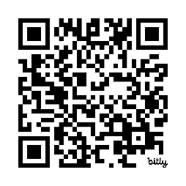
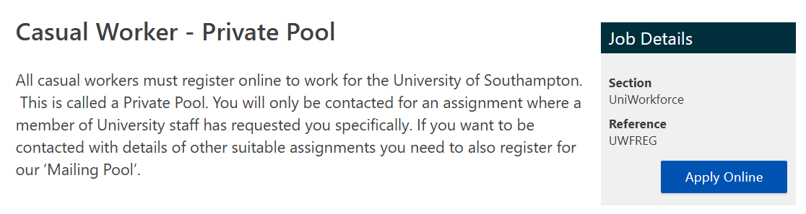


Sign up to a private pool
https://jobs.soton.ac.uk/Vacancy.aspx?ref=UWFREG
In one of the forms you fill out, you will be asked to provide your birthdate. If you are under 16 years old, you must tick ‘prefer not to say’.
Notes:
Once you have registered with UniWorkforce, use this new QR code to access the page for joining the private pool of casual workers. You will need to click Apply Online to be added to the pool.
Please note, if you are under the age of 16, you must select 'prefer not to say' when asked for your date of birth.

Slide 12

“Apply” for the job
Once you are registered in the private pool:
You will then be contacted to ”apply” for the job.
You will be asked to arrange an appointment to complete an online ‘Right to Work’ check before being able to start work.
You will need to have details of a bank account for where your salary can be paid into.
This feels like you are entering the same info again, but it is correct!
Notes:
Once you have been added to the private pool of casual workers, you will need to apply for the specific job we have set up for the NxtGen researcher programme. You will receive an invite to apply for the job, this will be sent to the personal email address you used in your application form.
Once you have applied, and your application has been processed, you will need to arrange an online 'Right to Work' check. This is to verify that you have the right to work in the UK. It is likely that you will need your passport, or some other UK national documentation to provide as proof. For example, a birth certificate.
You will also need bank account details available, to indicate where your salary can be paid into.

Slide 13

Registration confirmation
Worker’s name: | Xxx Xxx
Organisation: | University of Southampton
Casual Worker Permit Number (pay reference number): | 0000000
Hiring Manager: | Xxxxx
Work restrictions: | Under 18 years old specific working restrictions apply. Manager sent separate email guiding on restrictions. Please refer to UniWorkforce (Team Leader or Manager), if any questions.
Type of Work/Pay rate/Job Description | Xxxxxxx Duties will be agreed and confirmed by your line manager. Please consult your hiring manager for pay rate
Training: | You will be required to complete training relevant to your role e.g., health and safety/data protection
Hours of Work: | Your working hours will vary and will be communicated to you by your line manager
Place of Employment: | Reporting to address: UniWorkforce
Faculty/PSG: | Faculty of Medicine
Division/School/Dept: | School of Healthcare Enterprise & Innovation
Work start date: | xx/xx/xxxx
Projected work end date: Please note that your record will be closed automatically after 6 months of no payments being made to you. | xx/xx/xxxx Unless this contract is terminated earlier than this date in accordance with section 14 detailed in the Terms of Engagement.
Post number: | 0000-UWF
Job ID (OSRF) number: | xxxx-xx
You will receive an email that has a table in it that looks like this.
Note: The casual worker permit number is your reference number to use to set up payment.
Notes:
Once your application has been finalised and you have been approved for the job role, you will receive an email that contains all the details of your employment with the university.
The Casual Worker Permit Number is the number used to set up payment of your salary.
You will also need that number when creating a new university staff computing account.

Slide 14

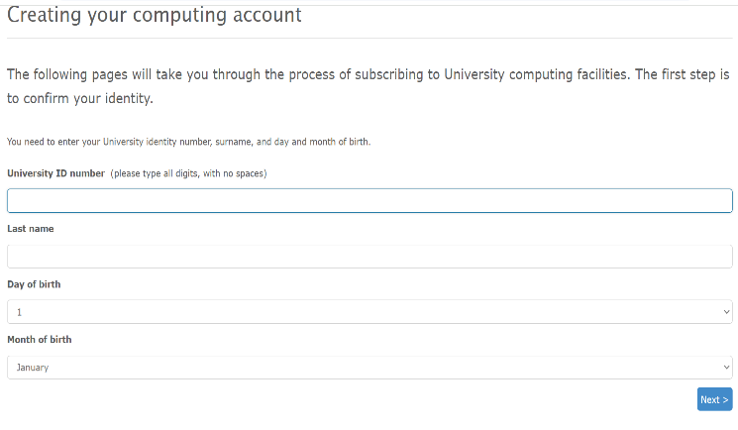
Email account set up
Click on the university subscribe website: https://subscribe.soton.ac.uk
Click “new staff and students”
Click “create your University computing account”
You should then see this screen.
Your University ID number is your casual worker permit number.
Enter the rest of your details.
Go through the rest of the questions and follow the steps.
Notes:
After being accepted for the job role, you will then be invited to create a university computing account.
Visit the website linked on the slide and click New Staff and Students, then select Create Your University Computing Account.
Use your Casual Worker Permit Number as the University ID number.
Complete the remaining steps and submit the form.

Slide 15
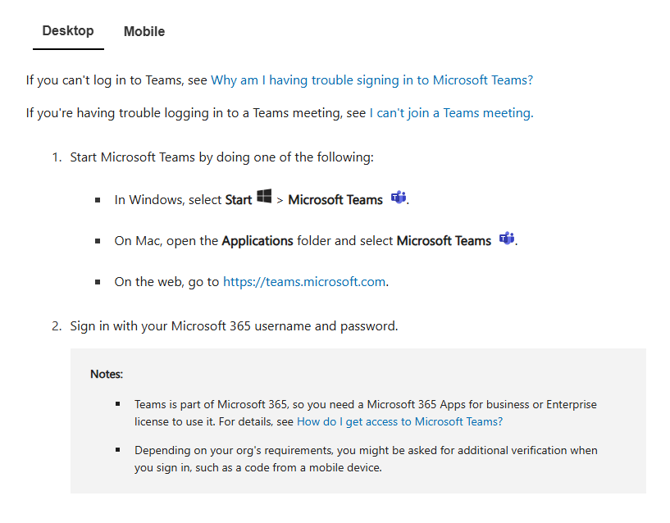
Log into TEAMs
Sign up to TEAMs with your university email address and set a password. Then log in.
We use Microsoft Authenticator!
Download the app and follow the steps to set up Authenticator.
Notes:
In order to access our NxtGen TEAMs site and save your work to your personal folder within it, you will need to log in with the university email address that has been set up for you.
The university uses Microsoft Authenticator to log in, so you will need to download the authenticator app to be able to log in with the two-step verification system.

Slide 16


Sign in
Have a go at signing in to your university email account and the TEAMs site that has been created for you, named:
NxtGen Researcher Programme 25-26
Send an email to:
  Subject: Test
  Message: Hello world.
Upload a photo to the 'Test' folder in TEAMs.
Notes:
Once you have logged into your university email account and access the NxtGen TEAMs site, complete the following tasks:
One: use your university email account to send an email to XX. Set the email subject to the word TEST and write the message Hello World.
Two: upload a photo to the TEST folder in your TEAMs site. This could be a photo of anything you wish.

Slide 17

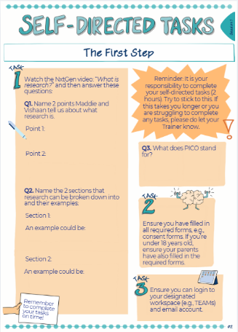
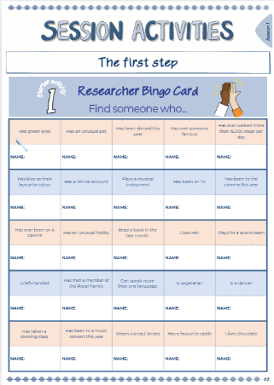
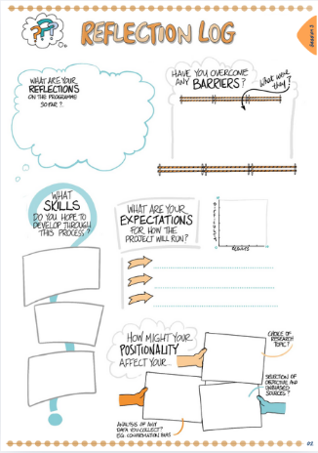
Your Workbook
Notes:
As part of the NxtGen Researcher Programme, you will have a workbook to complete each week. There are 4 different types of worksheet:
Session Activities to complete during the sessions
Self-directed tasks to complete at home, take photos and upload on TEAMs
Reflection Logs for each session to reflect on your work so far and journal your research progress, and
A blank page to take notes during each session.
It is important to use the workbook each week, as this will help to reinforce what we explore and learn each week, as well as document your reflections and findings.
If you are completing an EPQ or wanting to apply for a CREST award through the programme, then the workbook will be very useful in helping to write your reports.

Slide 18

Notes:
We are now going to take a 15-minute break.
Feel free to go for a short walk, get a drink or catch-up some more with other members of the group.

Slide 19




Activity 1: Build your branch
Collect three post-it notes:
1 x yellow
1 x leaf
1 x apple
Write the following answers on each one:
What will help you feel safe to contribute in this space? (The 'trunk' of the tree.) - Yellow post-it note
What will help you feel comfortable to contribute in this space? (The 'leaves' of the tree.) - Leaf post-it note
What will help you feel confident to contribute in this space? (The 'fruit' of the tree.) - Apple post-it note
Notes:
Our next group activity is all to do with understanding what we all need to make sure this space is supportive and comfortable for everyone.
This is a bit like the Grounds we wrote in the activity earlier but focuses on how you and we can make this programme safe, comfortable and give you the confidence to learn, explore and develop new skills.
Collect 3 post-it notes, one yellow, one green and one pink(?), the yellow will represent the trunk of a tree, the green for a leaf and the pink for an apple.
On the yellow post-it note, write one way we can make our space feel safe for you to contribute.
One the green post-it note, write something that will make this space comfortable for you to contribute.
On the pink post-it note, suggest how we can support you and help you to feel confident to contribute.
[Note to trainer: post-it notes can vary depending on your resources.]

Slide 20




Activity 1 continued
Feedback & discussion:
What will help you feel ____ to contribute in this space?
Safe?
Brave?
Comfortable?
We must have the 'foundations' (the trunk & leaves) to feel safe & comfortable, and once you feel this way, the 'fruit' can be produced, aka., you can thrive!
Notes:
Now, let's come back together and share some of your thoughts on how we can create the right environment for you to all contribute and thrive together.
[Note to trainer:
This activity entails a general discussion about group rules. For example:
Be respectful of other people’s opinions
Listen
Be on time
Contribute
Keep what is said in the sessions confidential – respect people’s privacy]

Slide 21




Activity 2: NxtGen discussion
Get into groups of 3 / 4 and discuss the following questions together:
What made you sign up for the NxtGen Programme?
What part of being a NxtGen researcher are you most excited for?
What do you think will be the most challenging part of the programme?
We will feed back to the group in 15 minutes.
Notes:
For this second activity, we are going to spend some time talking about you and the programme.
Why did you sign up? What are you most excited about in the programme? What do you think will be the most challenging part for you?
Talk in groups of 3 to 4 people for 15 minutes and we will then come back as a whole group to discuss.

Slide 22



Evaluation
Please complete the following evaluations:
Name​ | Alias / Participant #​
QR code
QR code
Notes:
We are conducting an evaluation of the programme, which requires you to complete surveys before an after the programme.
Scan the QR codes to access the two surveys you will need to fill out now, at the start of the programme.
Your Participant ID numbers are on the slide, alongside your names. You will need these in order to complete the surveys.

Slide 23
Q&A
Frequently Asked Questions
[If applicable] How does payment work and when do we get paid?
How do we submit self-directed tasks?
Why are we completing the NxtGen Researcher Programme?
Notes:
Let's now discuss some answers to frequently asked questions:
Payment is made at the end of each month. You will be paid one month in arrears, which means the work you do in one month is paid for at the end of the next month. For example, December's timesheet will be paid at the end of the January.
Self-directed tasks will need to be uploaded to your personal folder within the NextGen TEAMs site. Take clear photos of the worksheets for a session, so that each page can be read clearly. Go to the folder for that session, on the TEAMs site and upload the photos to the Completed Workbook Sheets folder. We will be checking these folders each week, and your payment will depend on completion of each week's tasks.
The last question is over to you! Why did you apply for the NxtGen Researcher Programme? Raise your hand if you'd like to share your reason...
This programme exists because we feel that young people should be the change-makers to help the communities that you and we live in. We want to hear about the matters that mean the most to you and help you to present those to the decision-makers who can make the changes you recommend.

Slide 24

Self-directed tasks
TASK 1​
Watch the NxtGeb video ‘What is research?’ to help you with the below tasks, then answer the questions in the workbook: https://bit.ly/LifeLab_NxtGen_WhatIsResearch
​
TASK 2​
Ensure you have filled in all required forms, e.g., Image release forms and consent forms. If you’re under 18 years old, ensure your parents have also filled in the required forms.​
​
TASK 3​
Ensure you can login to your designated workspace (e.g., TEAMs) and email account. Make sure you have completed your​ right to work check.
Notes:
In your workbooks, each session has self-directed tasks which you will need to complete at home.
Before the next session, you will need:
To watch the What is Research video. This will help you answer the Session 1 self-directed tasks in your workbook.
Please look after your workbooks, as they contain all your in-session, self-directed and reflection log activities for the whole programme. You will need to complete the tasks in the workbook, and then take photos to upload to your TEAMs folder as proof of completion.
Ensure all the required forms have been completed and signed. If you are under the age of 18, you will need a responsible adult to complete these for you.
Take some time to ensure that you can log into your university email account and access your folder on Microsoft Teams.
You will also need to make sure you have completed your right to work check. Otherwise, we cannot employ you on the programme and you will not get paid.

Slide 25



Feedback
On one post-it note per statement, please:
Tell us one thing you enjoyed today / learnt / found interesting
Tell us one thing we can improve on for next week
Name one future aspiration you have for yourself.
Write it on a post-it note and stick it up on the wall.
Notes:
One of our commitments to you is to learn from you about what is working well each week and find things we can improve.
Please let us know what you think, by writing on two post-it notes.
One note for one thing you enjoyed today, found interesting or a new thing you have learned.
Another note for one thing that could be improved on for the next session.

Slide 26
With thanks and acknowledgement of the generous support and funding from:

