Slide 1








How to be a reflective and reflexive researcher
STARTER ACTIVITY
Talk with your neighbours / partner about the research topic & research question you have chosen.
Session 3
Supported by
Notes:
Welcome to session 3: How to be a reflective and reflexive researcher.

Slide 2



Learning outcomes
LO1: Evaluate what it means to be a reflective and reflexive practitioner.
LO2: Explain the differences between a reflexive and reflective researchers.
LO3: Discuss the purpose of a Reflection Log and apply knowledge to create one.
Notes:
The learning outcomes for today are:
Evaluating what it means to be reflective and reflexive.
Explaining the differences between being reflective and reflexive, and
Discussing the purpose of a reflection log and applying that knowledge in creating one.

Slide 3







Why are we talking about this?
Application
>
>
Recruitment
Training
>
Change the
world
>
Shape the future
of health and
social care
>
Research
Notes:
So why are we talking about this today?
Well, you are about to embark on some research and for that research to be as effective and impactful as possible, it is important that you engage in reflective and reflexive practice, throughout your research.
These are skills which will be core to the research process, but they are also important for life in general too!

Slide 4


Activity 1: Let’s think about baking
Working in groups, write these six different headings on your post-it notes:
Description
Feelings
Evaluation
Analysis
Conclusion
Action plan
Notes:
We are going to start today’s session with a short activity.
As a group, write each of these 6 headings, on a post-it note.
[Note for trainer: While researchers do this, write the six headings on the whiteboard or put them on post-it notes on a wall.]

Slide 5
Activity 1 continued: Let’s think about baking
Now think about the last time you baked something and share this with the group. Collectively, answer the following questions on your post-it notes:
Description
Describe what you baked and what happened.
Feelings
Explain how you felt before, during and after baking.
Evaluation
What went well and what went less well?
When finished, one person per group, please stick your post-it notes under the correct heading on the whiteboard or wall.
Conclusion
What did you learn from the situation? What skills do you need to bake better next time?
Action plan
If you bake the same thing again, what would you do differently and why?
Analysis
Why did things go well or less well?
Notes:
Now, think about the last time you cooked something and share this with your group.
Using the prompts from the screen, add to each of your post-it notes.
For example, on the “description” post-it note, describe what you cooked and what happened. You will have 5 minutes to write on your post-it notes.
When you have finished, the post-it notes will need to go on the whiteboard. Can one person from each group collect all the notes and come to stick them on the whiteboard.
[Note for trainer: You can now read out some of the ideas which have been put forward.]

Slide 6

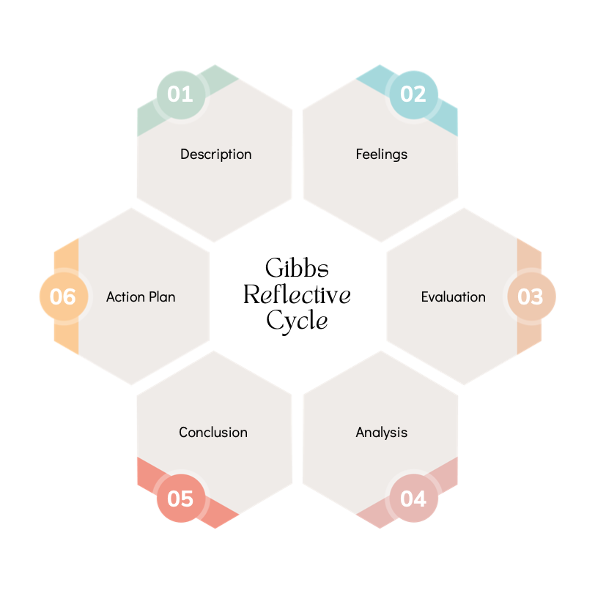


Gibbs’ Reflective Cycle
Surprise! You were just being a reflective researcher.
Gibbs’ Reflective Cycle is just one model of reflection (you don’t have to use this exact one).
Reflection should be a systematic process which allows you to make links and to learn from one experience to the next.
Notes:
In actual fact, what you have just been doing, is reflective practice.
You have used one model of reflection, called Gibbs’ Reflective Cycle, to reflect on an event and make an action plan for the future.
Whilst you may choose to use any one of the many models of reflection, it is a good idea to use a model.
Reflecting systematically will make your reflective practice more effective, and you will be less likely to miss steps.

Slide 7









Definition: Being reflective
Reflective practice involves …
  Looking back at past experiences, actions, or thoughts, and thinking about them critically. It's like looking in a mirror to see what happened, why it happened and how you can improve.
  Being reflective in research is beneficial because the process …
Helps develop confidence
Promotes continuous improvement and learning from experience​
​
Enhances the rigour and validity of research
  Encourages innovation
  Improves critical thinking
  Promotes self-awareness
  Informs future research
  Encourages adaptation
Notes:
What is reflective practice?
Reflective practice involves looking back at past experiences, actions, or thoughts, and thinking about them critically.
It's like looking in a mirror to see what happened, why it happened and how you can improve.
But why is it important? Well, it is beneficial in research, because it:
Helps develop confidence
Promotes continuous improvement and learning from experience
Enhances the rigour and validity of research
Encourages innovation
Improves critical thinking
Promotes self-awareness
Informs future research
Encourages adaptation
All of which are also important life skills!

Slide 8

Activity 2: Individual reflections
Consider your own research
Use Gibbs’ Reflective Cycle to reflect on at least ONE element of your practice or a hurdle you have overcome, for example, you could reflect on:
  The process of signing up to the Researcher Training Programme
  How you have chosen your research topic (if you have one)
Start with the description
Next: Discuss your thoughts with the person next to you!
Notes:
Now let’s put it into practice, and apply it to your research.
We're going to use Gibbs’ Reflective Cycle to reflect on at least one element of your practice, or a hurdle you have overcome.
Start with the description, just like we did before.
For example, you could reflect on:
The process of signing up to the Researcher Training Programme
How you have chosen your research topic (if you have one)
As an extension, you should discuss your thoughts with the person next to you.

Slide 9
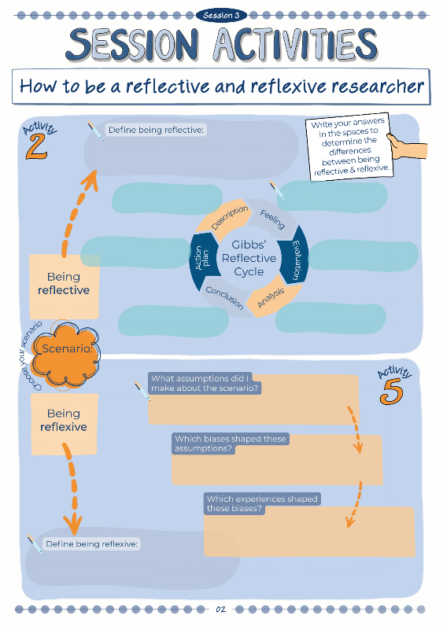
Activity 2 continued:
Add your reflections to the worksheet in your Workbook.
Notes:
Now that you have learned how to be systematically reflective, you can record your thoughts in this session's workbook activities.
You could choose to reflect on something different this time, or jot down your reflections from the last activity.
Notes for trainer: Access amendable version here https://www.canva.com/design/DAGDauePSQU/A2cQwk7SYTt_c8EjOdclJA/edit?utm_content=DAGDauePSQU&utm_campaign=designshare&utm_medium=link2&utm_source=sharebutton

Slide 10


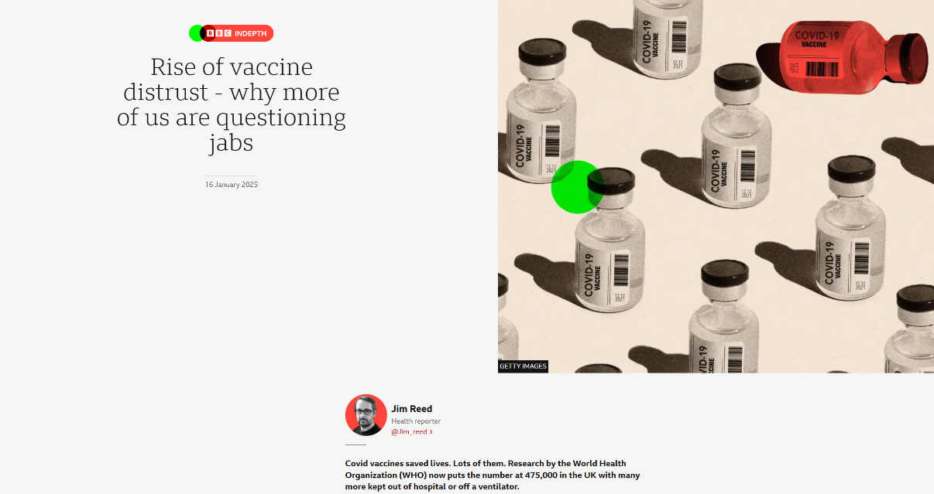

Activity 3: Being reflexive
Read the news headline.
What is your knee-jerk reaction?
Notes:
To get us thinking about reflexive practice, have a look at this news headline.
On your own (no obligation to share), think about your knee-jerk reaction. What are you thinking and feeling about this?

Slide 11

Activity 3 continued
Now rate yourself on each of these scales (you can do this privately; you don’t have to share):
 | 1 | 2 | 3 | 4
Does not agree with using vaccinations |  |  |  |  | Does agree with using vaccinations
Very little personal experience of receiving vaccinations |  |  |  |  | Lots of personal experience of receiving vaccinations
Notes:
Now, please rate yourself on each of these scales.
How much do you agree with vaccination and what is your personal experience with them?
You can do this privately – you don’t have to share.
Notes for trainer: IMPORTANT – do not insist that researchers share their thoughts; they may choose to, but they should have the freedom to be honest with this activity.

Slide 12


Activity 3 continued
Read the news headline again.
Consider how your internal biases might have influenced your reaction to the headline.
Notes:
Now, read the headline again.
The biases you just reflected on probably influenced your reaction.
Think for a minute about how and why that might have happened.

Slide 13



DEFINITION: Being reflexive
Reflexivity involves reflecting on your own beliefs, assumptions, and biases, and how they influence your actions and interpretations. It's like looking at the mirror itself, examining how your own perspectives shape your understanding of the world
Reflexivity is a key feature of learning. It goes beyond reflection to consider the wider social and political context and to question and explore assumptions that have previously been taken for granted. Therefore, it has the potential to enable researchers to critically examine their work and to identify how their underlying values, assumptions, and beliefs affect the synthesis, dissemination, exchange, and application of their research findings.
Notes:
In considering how your internal biases and experiences could have influenced your reaction to the headline, you were being reflexive.
These are just two definitions of reflexivity – there are others!

Slide 14





Summary
Reflexivity involves looking at things through a lens: the lens of your own beliefs, biases and assumptions.
It means thinking about why you believe certain things, why you react the way you do, and how your experiences and background shape your perspective.
Activity 4: Reflexively baking?
Think again about your baking example – can you suggest any ways in which you were reflexive during the baking process?
Notes:
Reflexivity involves looking at things through a lens: the lens of your own beliefs, biases and assumptions.
It means thinking about why you believe certain things, why you react the way you do, and how your experiences and background shape your perspective.
Think again about your baking example – can you suggest any ways in which you were reflexive during the baking process?
Notes for trainer: Researchers may think about things like dietary requirements, their own tastes, their prior ability in baking and whether they think they are good at baking or not, their intended audience’s tastes etc.

Slide 15

Summary continued
Reflexivity refers to all of the decisions you made in the moment, while you were baking.
You considered your own biases, the biases of your intended audience, and the appliances available to you, when you decided:
Whether to add any extra ingredients
Whether to cater for any dietary requirements
Whether it was OK to lick the spoon … !
Notes:
Reflexivity refers to the decisions you made in the moment, whilst you were baking. You did consider your own biases, as well as the biases of your intended audience and the appliances available to you when you decided these three things:
Whether to add any extra ingredients;
Whether to cater for any dietary requirements;
Whether it was okay to lick the spoon!

Slide 16


Definition: Positionality in research
Positionality refers to the position a researcher has chosen to adopt within a given research study (Savin-Baden & Major, 2013). It necessitates the researcher consciously examining their own identity to allow their readers (their audience) to assess the effect of their personal characteristics and perspectives in relation to the study population, the topic under study and the research process.
Notes:
Reflexive practice has a lot to do with the idea of positionality.
Positionality refers to the position a researcher has chosen to adopt within a given research study. Your positionality will be affected by your personal identity, characteristics and perspectives.
For example, when you do your own research, you will need to assess about the effect of your personal characteristics and perspectives in relation to the study population, the topic under study and the research process.
Note for trainer: Reference for definition - Identity, positionality and reflexivity: relevance and application to research paramedics - PMC (nih.gov)

Slide 17
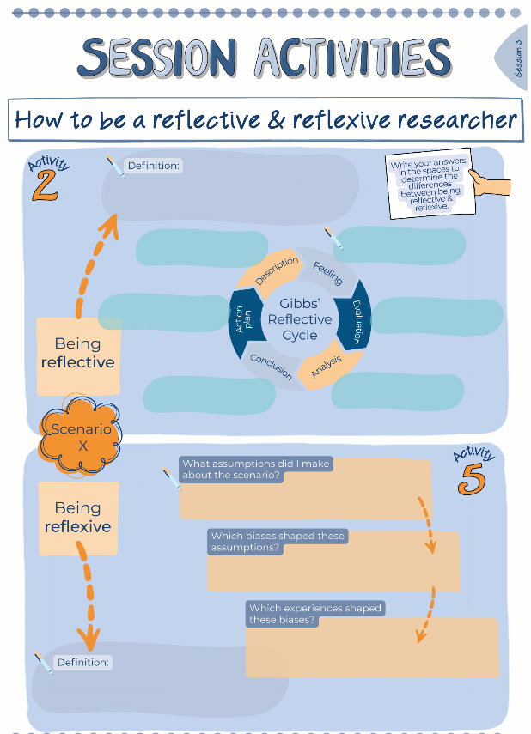

Activity 5: Being reflexive
Think about the same scenario you reflected on earlier
Use the prompts on the worksheet to add your thoughts: how did your assumptions, biases and experiences shape your behaviour?
Extension: Were you reflexive in the moment? In what way?
Notes:
Now that you have learned about positionality and reflexivity, you can use this page in your workbooks to record your thoughts.
Use the same scenario from earlier (not about baking …) and be reflexive about how your assumptions, biases and experiences will have shaped your behaviour.
You could also consider whether you might have been automatically reflexive in the moment. Did you think, at the time, about how your positionality might have been playing a role?
Note to trainer: You can access an amendable version here https://www.canva.com/design/DAGDauePSQU/A2cQwk7SYTt_c8EjOdclJA/edit?utm_content=DAGDauePSQU&utm_campaign=designshare&utm_medium=link2&utm_source=sharebutton

Slide 18







The differences between reflection and reflexivity
Being reflective
Being reflexive
"When deciding on a research topic, I reflected on my own internal biases and assumptions."
"I was initially a little unsure on …"
"During the process of choosing a topic, I grew in confidence because …"
"I knew I already believed …"
"I kept this in mind while selecting sources, being careful to choose sources from a range of authors with a range of perspectives on …"
"What I found went well was … because …"
"This was possibly due to my own experience of …"
"Next time I need to choose a research topic, I will …"
Notes:
So, we have thought about two very connected but slightly different skills of research.
If you’re still unclear on the difference, hopefully these sentence starters help clarify things…

Slide 19




Activity 6: reflective or reflexive scenarios
Who is being reflective and who is being reflexive?
Vishaan has previously had bad experiences with a co-worker named Jacko. This has led to him having unconscious bias which means he automatically assumes the worst in people named Jacko. During his research project, this impacts his results. Vishaan picks up on this and does his best to rectify the issue. Is he being reflective or reflexive?
Maddie has just conducted interviews about vaping for her research project. She is generally pleased with her results. However, she’s looking back at some of the questions she asked and wishes she’d phrased them differently to enable her to deepen the conversation.
Is she being reflective or reflexive?
Sophia is conducting an observational task where she observes people’s morning routines without interfering. Whilst she is not playing an active part in the events, Sophia tries to recognise how her presence alone may have impacted her results.
Is she being reflective or reflexive?
Notes:
Let’s put our knowledge to the test: which of these students are being reflective, and which are being reflexive?
Are any of them doing both?
[Note to trainer: Maddie is being reflective, Vishaan is being reflexive, Sophia is being reflexive.]

Slide 20

Notes:
We are now going to take a 15 minute break. Feel free to go for a short walk, get a drink or catch-up some more with other members of the group.

Slide 21
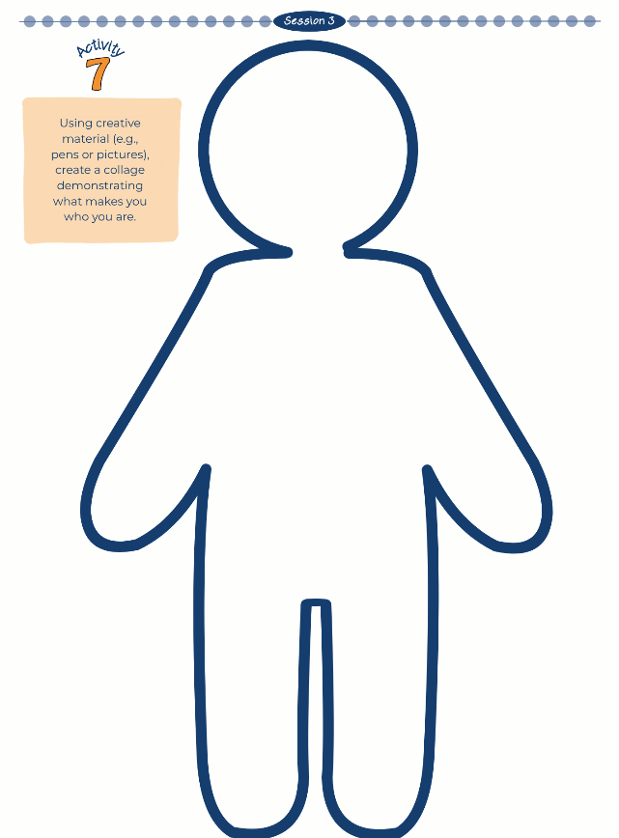


Activity 7: Collage creation
‘What makes you who you are?’
Create a collage based on the question, “What makes you who you are?“ in your Workbooks.
Collages can be word, picture or image-based (or a combination).
There are no right or wrong collages.
Be as creative as you’d like!
How does this link to being reflective and reflexive?
Notes:
For this activity, we are going to spend some time now thinking about what makes you, you.
How does this activity link to what we have discussed so far today?
Turn to the relevant page in your workbooks to find the outline of the person. Find some magazine or newspaper cuttings or draw images inside the outline, to represent what makes YOU who you are. There are no right or wrong collages!

Slide 22

Activity 8: discuss being reflective and reflexive
[With the person next to you]
Extension for both of you: Think of an assessment you’ve recently had at school or college, or some training you've done at work. Use your skills (such as Gibbs’ Reflective Cycle) to reflect on the assessment process from completing it ... to receiving feedback … to moving on from the feedback to make progress.
Person 1: Explain what it means to be reflective
Person 2: Explain what it means to be reflexive.
Notes:
With the person next to you, discuss and explain what it means to be reflective and reflexive. What can you remember?
Think of an assessment you’ve recently had at school/college, or some training you've done at work.
Use your skills (such as the Gibbs’ Model) to reflect on the assessment process: from completing it, to receiving feedback, to moving on from the feedback to make progress.

Slide 23
Why are we talking about this?
>
>
Application
Recruitment
Training
>
>
>
Change the
world
Shape the future
of health and
social care
Research
Notes:
Why are we talking about this today?
Well, you are about to embark on some research, and for that research to be as effective and impactful as possible, it is important to engage in reflective and reflexive practice throughout your research.
These are skills which will be core to the research process, but they are also important for life in general too!

Slide 24




Your Reflection Log
Do you think a Reflection Log is an example of reflective practice, or reflexive practice?
A Reflection Log is a document used to record your journey through the research process. In your Reflection Log, you can …
Reflect honestly on your ideas, your learning and the successes (or failures) of your research, as it happens.
Write down ideas for what you will do and the information you want to find out.
Keep all your ideas together in one place, so you can refer to them.
Reflexive
or
Reflective?
Notes:
Your workbook contains Reflection Log pages for each session, from Session 3 onwards.
These are opportunity to look back on your progress so far and document what you have learned so far, what has gone well and where things could be improved.
You can:
Reflect honestly on your ideas, your learning and the successes (or failures) of your research, as it happens.
Write down anything you are finding difficult.
Write down ideas for what you will do and the information you want to find out.
Keep all your ideas together in one place, so you can refer to them.
Do you think a Reflection Log is an example of reflective practice, or reflexive practice?
Trick question - it is both!

Slide 25
Reflection Log – how will it be assessed?
Clear identification of the topic to be investigated.
Clear evidence of appropriate aims and objectives.
Detailed project planning, with evidence of monitoring progress of project work against your chosen objectives.
Evidence of detailed research.
Evidence of appropriate procedures being followed including ethics and safeguarding considerations and procedures.
Careful selection of appropriate sources of information.
Evidence of appropriate decision-making.
Evidence of thorough data analysis.
Clear evidence of flexibility of the researcher, through a log of appropriate changes to or development of the initial project plan/ title/aims and objectives, with reasons for any changes.
Detailed and careful evaluation of strengths and weaknesses of the project itself including planning, implementation, and outcomes.
Reflexivity and reflectivity is evident throughout and demonstrates the researcher’s own learning journey.
Notes:
Here’s how your Reflection Log will be assessed.
Have a read and note the importance of reflective and reflexive practice throughout.

Slide 26


Activity 9: Reflection log
Describe your experience of completing a research project before.
What are you going to do next?
What did you learn from the process of completing a project previously? How will you apply this learning to the current project?
One component of your self-directed tasks this week will be to start reflecting on your research journey via a Reflection Log.
Discuss your reflections with the people on your table.
Here are some prompt questions to help you:
What successes OR challenges did you experience during previous projects?
Describe the process of choosing your research topic. Why do you want to research this topic? What outcomes do you hope to achieve?
What challenges do you anticipate you might face? What resources will you need, to overcome these challenges?
What challenges are you currently facing, and how do you plan to overcome them?
What research skills do you already have? What skills are you aiming to develop through your new research project?
Notes:
And there’s no time like the present!
One component of your self-directed tasks this week will be to start journaling your research journey via a Reflection Log.
Discuss with your table what a Reflection Log might include.
Use the prompts to help you.

Slide 27


Self-directed tasks
Task 1: To prepare for the next session, watch the video ‘Desk research’.
Task 2: Start your Reflection Log and use it to start thinking about your own positionality as a researcher – where are you coming from? Background? Values? Ethnicity? Biases?
Notes:
Before the next session, your self-directed tasks will be to:
You will need to prepare for Session 4 by watching the Desk research video.
Complete the reflection log for Session 3. You may also want to add some reflections about the first 2 sessions. You could write some notes down in the blank note pages.

Slide 28


Feedback
On one post-it note per statement, please:
Tell us one thing you enjoyed today / learnt / found interesting
Tell us one thing we can improve on for next week
Name one future aspiration you have for yourself.
Write it on a post-it note and stick it up on the wall.
Notes:
Now it is time for our usual feedback activity, please find two post-it notes.
One note for one thing you enjoyed today, found interesting or a new thing you have learned.
Another note for one thing that could be improved on for the next session.

Slide 29
With thanks and acknowledgement of the generous support and funding from:

