Slide 1








Desk research
STARTER ACTIVITY
If you could design and name your own search engine, to rival ‘Google’, and ‘Yahoo’, what would you call it and why?
Discuss with your neighbours whilst we wait for everyone to arrive!
Session 4
Supported by
Notes:
Hello and welcome to Session 4 of the NxtGen Researcher Programme. In this session, we will be looking at desk research, the different sources of research and finding reliable sources.

Slide 2



Learning outcomes
LO1: Describe the differences between primary and secondary research.
LO2: Evaluate the reliability of methods used for desk research.
LO3: Discuss the importance of representation in research.
Notes:
The learning outcomes for this session are:
Describing the differences between primary and secondary research.
Evaluate the reliability of methods used for desk research.
Discuss the importance of representation in research

Slide 3



What is desk research?
Desk research is all about looking for information someone else has already collected and written about or published.
  Why do we start with desk research?
  How does it help us with our research?
  Is it important?
Activity 1: Desk research discussion
In pairs/groups, discuss and write down some ideas on post-it notes.
Notes:
[Note to trainer: The researchers should have watched the video on desk research in preparation for the session, so should know what it is and what it involves. Ask them to discuss the questions on their tables and then share to the rest of the group.]
Our first activity for this session is to recall what you have learned from the desk research video.
Works in pairs or groups to discuss the key points from the video and write some down on post-it notes, to share with the room. You have 5 minutes before we share our thoughts together as a room.
Note to trainer: Ideas to share if they don’t contribute them –
Desk research means you can make a summary of what is already known about your topic or theme.
Doing desk research might help you decide what data you want to collect.
Doing desk research helps you refine or focus in on your topic.
If you don’t know what has been done before, you might not know what information will be new to find out.
If you know something about the topic, you should be more credible when interviewing people.

Slide 4


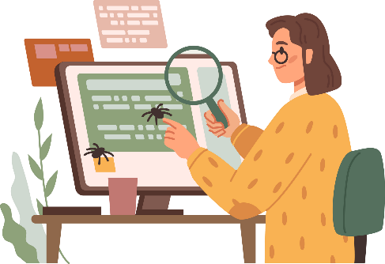
Primary or secondary research?
If we go and collect data,
it is…
Desk research is…
secondary research.
primary research.​
Notes:
When we think about carrying out research, we say that desk research is secondary research. [click]
Going and collecting data yourself is primary research [click]
Remember that if you collect data, you are the first person to collect data, so ‘primary’ or first
If you read someone else’s research, they have collected it, so you aren’t the first!

Slide 5





Activity 2: All about cake …
FIRST, what is your favourite type of cake?
Write it down on a post-it note (don’t let anyone else see!)
SECOND, let’s work out our results.
We have just collected primary data to answer the question – What is the favourite type of cake of this group?
THIRD, let’s do some desk research and see if we can find what the world’s favourite type of cake is. We will be finding secondary data. Use your device and see what you can find out in 3 minutes.
FOURTH, once you have some answers, keep the web page open and note the source – which website/author/name of article?
Notes:
In this next activity, the aim is to find out which websites are visited to find the information.
Can they be trusted? Are they really revealing research or just someone’s opinion?
Firstly, write down your favourite type of cake on a post-it note.
Secondly, collect all the post-it notes for your group. Is there a common favourite? Which is the most popular?
You have just collected primary data!
Next, conduct some desk research to find out the world's most favourite cake. You will be finding secondary data, using your devices.
Finally, once you find a webpage with an answer, keep that page open and note the source.
What is the name of the website? Who is the author? Does the article have a name or title?
Discuss the results using the next slide.

Slide 6





Activity 2 continued
Which type of cake is the world’s favourite cake?
How do we know if the answers you found are based on research?
Time to share your ideas! Think about these questions:
Is our desk research reliable?
Where did you find the information?
Notes:
[Notes to trainer: To discuss the research done online -
Find out what information the researchers have found online and tally it up. What is the world’s favourite type of cake?
Ask where they found the information. Which website? Who is the author? Does it say?
Are the answers found based on any real research, eg a poll or survey of x thousand people? Or are they just the opinions of those writing the articles?
If the articles are based on research, they might tell us that in an opinion poll, or might mention a survey, or how many people were asked the question.
5) For interest, compare the results online to what the group’s favourite cake was, to see if the group’s data is representative and if not, why not?]
Let's discuss the research you did online:
We're going to tally up the cakes that you each found to be the world's favourite cake. Did you all find the same cake?
Where did you find the information? Does the webpage state an author?
Were the answers based on real research? That could be a poll or survey of a large number of people. Or is the answer based on the author's opinion?
Compare the research results to our post-it note results. Is our data representative of the online research data? If not, why?

Slide 7












Finding reliable results – possible sources
Internet search engines
Libraries and books (may be online)
Newspapers or news outlets e.g. BBC
Surveys e.g. the England & Wales census
Academic databases e.g. Google Scholar
Notes:
Where can you find out information? Where would you go and look for information?
[click] Internet search engines - the world's knowledge is at your fingertip. However, you may have no idea if things you find are always true, and you may need to go through millions of results with no confidence if you can trust them.
[click] Libraries and books – Although this is a limited resource and books can have outdated information, to be published books have usually gone through a publishing process with editors / lawyers etc.
[click] Newspapers or news outlets – While we can usually trust popular new outlets, their reliability can also depend on their corporate associations and how that may affect things like political bias
[click] Surveys – government surveys should be accurate, in some countries that isn't always the case. It is worth looking into who has conducted the survey and how many people completed the survey. A census will be more reliable than a BuzzFeed article survey.
[click] Academic databases – these should be reliable, as academic publishing goes through a review system before publication. Examples are Google Scholar, Embase or Scopus (Embase and Scopus are for biomedical/medical research). They give you more reliable findings but may not be open and accessible to everyone, as some need a paid subscription.

Slide 8






Activity 3 - Stage 1
“How does smoking affect your chance of developing dementia?”
What’s the question?
Have your research question ready, so you know what you want to find out.
For example:
Notes:
This activity is all about identifying the key words and phrases associated with the research question for your own projects.
Let's take this question as an example [click]: How does smoking affect your chance of developing dementia?

Slide 9



Activity 3 - Stage 2
Keywords / phrases
“How does smoking affect your chance of developing dementia?”
Break down your question or topic into key words.
For example, with the question “How does smoking affect your chance of developing dementia?”, can you pick out the key words or phrases from that question?
“dementia”
“affect”
Now it’s your turn …
“smoking”
“developing”
Notes:
What key words can you identify from this research question? Talk to the people near you for 2 minutes, before we come together to share your thoughts.
What did you find? [click] here are the ones we identified to be crucial to defining the research question. Dementia, Affect, Developing and Smoking.
Find the first session activities page for Session 4, in your workbooks, and start to complete the same activity but identifying key words for your own research question.

Slide 10


Activity 3 - Stage 3
Synonyms & plurals
Create synonyms for your keywords and phrases and think about plurals and singulars of the words.
“dementia”
Alzheimer’s
senile dementia
“smoking”
smoker
smokers
Now it’s your turn…
“affect”
influence
cause
“developing”
develop
causing to grow
Notes:
[Note for trainer: Ask for contributions before revealing the bullet points. Then ask them to continue completing the activity by adding ideas for synonyms and plurals for their keywords.]
A synonym is a word or phrase that means exactly or nearly the same as another word or phrase in the same language, for example shut is a synonym of close.
Let's take the word dementia, what else could be used as a search term instead of dementia? [click]
How about smoking? [click]
Affect? [click]
And finally, developing? [click]
Complete the synonym section of the session activities, finding alternative words or phrases for your research question key words.

Slide 11






Activity 3 - Stage 4
Searching tips
Truncation: instead of writing teen, teens, teenage, teenager, teenagers, you can use an asterisk and change it to teen*
Phrases: Use “ ” around keywords that are more than one word e.g., “Mental health”
Here are tips to help your search strategies:
Boolean operators: Use ‘AND’ to search a term alongside another and ‘OR’ to search a term in comparison with another e.g., “vaping AND teen*” or “youngster OR teen*”.
Wild card: Spellings vary from one country to another eg colour / color –use a question mark to solve this when you search, so you would write ‘col?r’
Notes:
When searching key words and phrases online, there are some codes and tips for getting the most out of your search:
Truncation is where you can shorten a search term to a word that is found in other longer words. For example, writing 'teen' with an asterisk at the end will search for any words that begin with 'teen', like teenage, teenager or teens.
If you would like a phrase, with more than one word, to be searched as a whole term, add quotation marks around them. For example, adding quotation marks around the phrase 'mental health' means that the search engine won't search for results associated with 'mental' or 'health' by themselves.
Boolean operators are used to carry out a search that compares two terms.
[Note for trainer: Add anything that might be useful for their own research into the box on the worksheet e.g., how can they use 'AND’.]

Slide 12



Stage 3 continued: Boolean operators
Boolean operators
Using ‘OR’
Results in both circles will be identified.
Children
Using ‘AND’
Mental health
The section in the middle will contain information relating to all three.
Physical activity
Notes:
If you use OR, you’ll widen the search to pull out results that match any of your search terms, [click].
For example, if you say ‘Children OR Mental Health', it will return results for 'children', 'mental' and 'health’.
[click] If you use AND, you’ll pull out results that include all your search terms.

Slide 13

Activity 3 - Stage 5 – referencing
Referencing
If you use information you have found as part of your research, you must say where it came from to reference it.
You will need to give details about the writer/journalist/scientist who wrote the article or book that you have read, where it was published and when
This is called ‘citation’ or ‘referencing’ and there are different ways of writing this information out e.g. the Harvard Method might look like the example in the box below.
Citation
Referencing
Russell, J, 2023. The implications of pasta shape and size on children between ages 4 and 8. [article] Journal of Important Things. Volume 94: 48-52
Example:
Notes:
Referencing is really important – it acknowledges where you have taken your information and helps to give credibility to your work. You must reference not only articles and books, but any websites or other sources of information. We will cover referencing in a bit more detail in a later session.
You need to give enough information, so that someone reading your work can go and find the source material themselves.
In this made up example, there’s the author’s name, the year it was published, the title of the article, the place it was published and the exact volume and page numbers. You also need to reference web pages / anything published anywhere on the internet.

Slide 14

Notes:
We are now going to take a 15-minute break. Feel free to go for a short walk, get a drink or catch-up some more with other members of the group.

Slide 15




Activity 4 – Searching for key facts
Complete the worksheet by finding at least THREE key facts that could be useful for your research.
How reliable do you think the sources were?
If reliable, why was this?
If not reliable, why not?
Notes:
[Notes for trainer: Give researchers 5 mins to find some facts out relating to their own research topic, and then share on their tables, then ask tables to feed back to the whole group about reliability.]
The last part of the worksheet involves searching for reliable information. You will need to find three key facts that could be useful for your research.
What ways can we make sure that the information we use is reliable? [click]
Did you fact check your sources? How many sources were saying the same thing, were any saying something different? Why do you think there are differences?
Where did you find the information?
Is the author known or reputable?
Did the authors explain where the information came from? Or is it vague how they came to their conclusions?

Slide 16

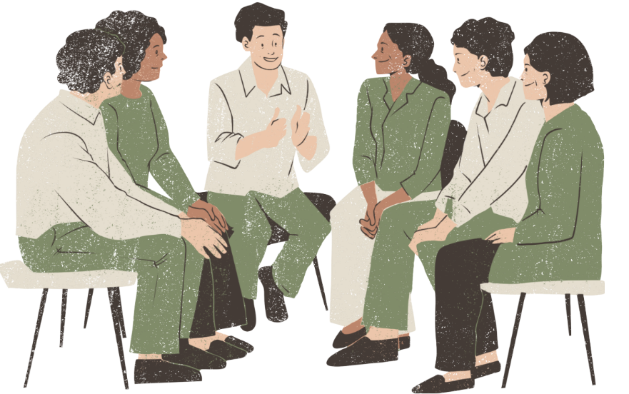
Representation
Making present something which is absent.
Speaking or doing something for another person.
Notes:
Now that we've covered the fundamentals of desk research and literature searches, let's shift our focus to a critical aspect of conducting research: representation.
While background research is essential, it's equally important to consider who we're including in our studies.
Let's explore why thinking carefully about our research participants is crucial for producing valid and ethical research.
What does this word mean to you?
[click] When we’re thinking about it from a research perspective, we’re thinking about ‘making present something which is absent’, ensuring that we try to capture all voices and ‘speaking or doing something for another person.’ [click] This is one of the things we are trying to do with research, we’re trying to capture data from people and represent it to others to affect a change.

Slide 17


Representation - researchers and participants
Researchers need to be representative
For example, black women make up less than 2% of all professors in in UK Higher Education (HESA)
People participating in research
For example, in the UK, areas and communities with the highest burden of disease also have the lowest number of patients taking part in research (NIHR)
Notes:
But, we all bring our own internal biases – as we’ve already learnt about, and so let's think about who is doing the research...
It’s why programmes like this are so important, to increase the diversity not only of the people doing the research, but also of the people participating in the research.
Community research is so important – people in their communities know them best, they understand the challenges and can see opportunities that someone from the outside won’t know.
There’s also evidence to show that people are more likely to talk to researchers from their communities.
For example, young people are more likely to talk to other young people than to unknown researchers, and the information they provide is more likely to be authentic.
This is why this training programme has been established, because it’s really important that community researchers can also reflect on their own internal biases and do what they can to ensure representation in their research.

Slide 18


Over to you to discuss …
Does it matter who we are as researchers?
Does it matter who our research participants are?
Discuss on your tables
Notes:
Here are some questions to discuss on your tables. We'll share our thoughts in 5 minutes.

Slide 19

Situated knowledge
Any knowledge is informed by the location and position of the knowledge producer.
It does not mean that knowledge is weak!
It means that knowledge by and of the “marginal” or “oppressed” is crucial for “good knowledge”.
Notes:
A few final thoughts for you to reflect on:
Whenever we carry out research, the data that is collected is always informed by the location and by the positionality of the researcher.
For community research programmes, this is absolutely key – this is why we do it – we need the knowledge and insights from communities, and it’s important to recognise how powerful this knowledge is, and that rather than seeing this knowledge as ‘weak’ or lesser than ‘pure’ research, actually, that is the power of community research, that it’s being driven by local need and insight.
With this training programme, we’re equipping you with the skills to collect authentic, rigorous data that is community-based.
Really, this reinforces how important it is that knowledge that is collected and shared has to include and be driven by people who represent the community’s needs.

Slide 20

Self-directed tasks
Recap on the top tips you have heard today about searching effectively on the internet or on databases.
Answer the questions in your workbook.
Carry out some desk research for your research question – don’t forget to note down the sources of information and assess the reliability of the information you have collected
Complete an entry in your Reflection Log with thoughts about your desk research. Has it been useful? What have you learned? Has it helped refine your research question further?
Watch the next video ‘Research methods’ and answer the questions.
Notes:
Your self-directed tasks for this week are to:
Remind yourselves of the tips shared today about effective online search methods.
Complete the self-directed tasks for this session, in your workbooks.
This involves searching for more reliable information surrounding your research question.
Complete the reflection log questions, reflecting on the usefulness of your research sources.
Watch the 'research methods' video, in preparation for the next session.

Slide 21



Feedback
On one post-it note per statement, please:
Tell us one thing you enjoyed today / learnt / found interesting
Tell us one thing we can improve on for next week
Name one future aspiration you have for yourself.
Write it on a post-it note and stick it up on the wall.
Notes:
It's that time again for post-it note feedback.
One note for one thing you enjoyed today, found interesting or a new thing you have learned.
Another note for one thing that could be improved on for the next session.

Slide 22
With thanks and acknowledgement of the generous support and funding from:

