Slide 1








Research ethics
STARTER ACTIVITY
Brainstorm any
words that could be
associated with ethics
and research.
Write them on a post-it note, stick it on the board and let’s see the word cloud we create…..
Session 6
Supported by
Notes:
Welcome to Session 6 of the NxtGen Researcher Programme. This week is all about the role and importance of ethical research.

Slide 2



Learning outcomes
LO1: Discuss the role of ethics in relation to carrying out research projects.
LO2: Explain the eight principles of taking an ethical approach.
LO3: Apply knowledge and prepare an ethics application.
Notes:
The learning outcomes for today are:
Discuss the role of ethics in relation to carrying our research projects.
Explain the eight principles of taking an ethical approach.
Apply knowledge and prepare an ethics application.

Slide 3





What are ethics?
What are ethics?
Ethics …
… relate to right and wrong
… are moral principles that govern how research should be carried out
… are very important when doing research!
Notes:
What are ethics?
[Note to trainer: Allow 1 or 2 minutes for the researchers to show what they know already.]
Ethics relate to what is right and wrong, they are moral principles that govern how research should be carried and are crucial to doing research correctly.

Slide 4





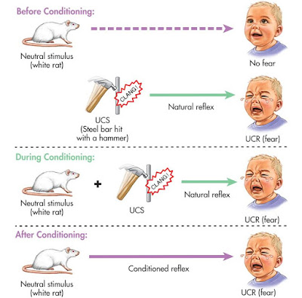

Activity 1: Case studies
Consider in groups: What do you think is unethical about these two pieces of research?
Notes:
We are going to split you into groups and assign each one a case study.
Discuss what is unethical about these pieces of research and we will come back together to share your thoughts with the room.

Slide 5



Activity 1A: Tuskegee syphilis study
Participants were low paid, uneducated men, some had the disease of interest (syphilis), some didn’t (some didn’t know they had it & weren’t told)
Told they were being treated for ‘bad blood’
Given free medical exams, healthcare, food and promised burial insurance
If syphilis is untreated, it can cause organ damage, paralysis, blindness and even death
Some of the participants were given treatment, some weren’t (even if they needed it) in order to test which treatments worked best
If you know someone has a treatable disease, is it ethical to not provide treatment?
Notes:
One of the extreme cases that are famous for being unethical include the Tuskegee syphilis study (where some syphilis sufferers were not treated even though they had the disease).
[click] Do you think it is ethical to not provide treatment for a disease, if you think you know someone might have a treatment? Read the information on this slide and discuss with the people next to you.
[Notes to trainer: Run through bullet points and then ask groups to share their thoughts. Pose the final question…..]
Sometimes unethical studies are obvious to identify, such as the two we have looked at today. Others might not be immediately recognisable as unethical, such as studies funded by companies with particular agendas, like promoting their own vaccines or medicines. Ethics are vital to keeping everyone safe.

Slide 6

Activity 1B: 'Little Albert' experiment
Aimed to see if it is possible to condition an emotional response.
Consent was gained from Albert’s mother.
Researchers tested Albert’s normal reactions to stimuli – he was unafraid of mice, rats, a monkey, masks.
Researchers started to ‘condition’ Albert by having a loud sound to scare him immediately after showing him a white rat.
After only two sessions, a week apart, Albert was afraid of the rat even without the noise.
Notes:
Another unethical study which is well-known is the Little Albert experiment, in which a baby played happily with a white rat, showing no fear.
He was then conditioned to become fearful as every time the rat appeared, there was also a loud noise.
He soon feared the rat even without the noise and became fearful of other similar animals and anything that was fluffy and white, including Santa Claus with his white beard.
[Notes to trainer: Run through bullet points and then ask groups to share their thoughts.]

Slide 7




Principles for ethical research
Informed consent
Voluntary participation
Minimising risks & harm
Confidentiality
Research integrity & transparency
Anonymity
Rights & dignity of individuals
Results communication
Notes:
Research is based on some core principles, which include:
[click] Informed consent: We use ‘participant information sheets’ to give information to people who want to take part, and if the person still wants to take part, they have to sign a consent form. Usually when under 18s are involved, parents give consent for their child to take part, and the young person gives their assent. However, we also have a process, whereby a ‘Gatekeeper’ could give their approval that the young people involved can give consent and aren’t ‘vulnerable’ in relation to the proposed research.
[click] Voluntary participation: Allowing participants to join or leave the study freely.
[click] Confidentiality: keeping information private when finding out about individuals, communities or organisations, and ensuring research results are kept secure afterwards. For your research, your participants must use pseudonyms and although you will know who they are, you will not be associating their real names with their data. We will use secure data collection methods via an app called Epicollect5 or via a survey platform called Qualtrics.
[click] Minimising risk & harm: Ensuring participants and researchers themselves are protected from physical, emotional, and psychological harm throughout the research process.
[click] Anonymity: Ensuring participants cannot be identified in the research, even if interviewers/focus group researchers may know their participants, which is why confidentiality is so important. It is essential that in any write up or presentation of results, no-one can be identified from the results (i.e. quotes don’t mention the name of the person, locations are not detailed, organisation names are not mentioned. For example, schools, colleges or workplaces.)
[click] Rights and dignity of individuals: Respecting all participants throughout the process.
[click] Results communication: Sharing findings responsibly and accurately.
[click] Research integrity and transparency: Conducting and reporting research honestly and openly. Researchers being truthful with the participants. Researchers should avoid any deception and ensure that participants understand the motives of the research
[Notes for trainer: Print out the 8 slides with the 8 ethical principles on (SESSION 2 – ACTIVITY 2 – Research ethics principles activity) and give one each to pairs or small groups of researchers. Researchers need to read and think about how this principle might apply to carrying out their own research projects – can they think of how they will maintain confidentiality, or obtain consent, or minimise risk, for example? How will they ensure participation is voluntary, and that their participants know what the research is and how the results will be used?]
Possible questions for them to answer:
How can you maintain confidentiality? If you interview several people in a group, how can you ensure information stays private?
How can you make sure the rights of your research participants are respected, and their dignity remains intact when you are interviewing them?
Will all your participants want to read an information sheet and initial a consent form?? How can you help them to be motivated to do this?
How can you make sure your participants feel safe and comfortable? Look up the Stanford Prison experiment conducted in 1971 as an example of what not to do!
How can we ensure that we maintain integrity and transparency when carrying out research as part of NxtGen? How will you tell your research participants about your research?
For NxtGen research, part of the process involves asking for the help of ‘Gatekeepers’ who will assess potential research participants. In what other ways can you ensure you minimise any risk or harm? What does ‘safeguarding’ mean and how is it relevant?
Key language use – https://www.saverauk.co.uk/hba-media-guidelines/language-key-terminology-dos-and-donts/ ]

Slide 8




Activity 2 – Ethical principles
Discuss how these ethical principles relate to your research and methods
Considerations: How will you …
… ensure confidentiality?
… obtain consent?
… minimise risk/harm?
Look up more information on your device if needed.
Be prepared to feed back to the group in 10-15 minutes!
Notes:
Thinking about everything we have discussed so far, talk through how these principles apply to your research. We will share thoughts together in 10 to 15 minutes.
[Notes for trainer: Check in to make sure they are happy discussing these principles and have planned who will feed back to the rest of the group – one person can give some definitions perhaps, another can talk about how this ethics principle might apply to their own research, and what they can do to ensure consent is given, or that they are making research participants comfortable.]

Slide 9

Notes:
We are now going to take a 15 minute break. Feel free to go for a short walk, get a drink or catch-up some more with other members of the group.

Slide 10






Safeguarding
Here are some points to consider about safeguarding:
1. Plan for potential issues during your research.
2. Know where you can go for support.
3. Always conduct interviews with another person present and be in a safe location.
Notes:
As trainers, we have a duty of care both to you, as our researchers, and also to your research participants. We have a specific session about safeguarding, where we will talk about scenarios and how you can prepare. However, the key things to always bear in mind are:
[click] to plan ahead – this isn’t to expect the worst, but to have thought through possible issues, so you are prepared.
[click] to know where you can go to for support.
[click] to always think through your data collection, you should never be alone, and you should always be in a safe place.

Slide 11












Process to follow to begin data collection
Gatekeepers
A gatekeeper is an adult that will help you keep yourself and your participants safe.
Young researchers will share the list of potential participants with Gatekeepers
Gatekeepers will confirm suitable participants to approach (who are not vulnerable) from the potential participants list
Gatekeepers along with the research team will support young researchers to identify a suitable location (classroom/private space) where they can hold their interview/focus group with their research participants.
Gatekeepers will distribute the ‘Participant information sheets and consent forms’ to the proposed participants, with the accompanying briefing note.
Gatekeepers will inform young researchers in a sensitive manner to not approach vulnerable/not suitable participants from the potential list.
Gatekeepers will collect initialled consent forms and confirm with the young researcher that they can proceed with data collection. Research team will collect the initialled consent forms from the gatekeepers
Researchers will identify potential participants from their communities, schools, other youth settings or other peer groups
Researchers with the accompanying briefing note will start collecting data.
Notes:
This is one of the possible processes to follow before we begin data collection, if you require the use of a Gatekeeper.
[click] Firstly, you will identify potential participants from your communities, schools, other youth settings or other peer groups.
[click] You will then share the list of potential participants with your Gatekeeper.
[click] Gatekeepers will confirm suitable participants to approach (who aren’t vulnerable) from the potential participants list. AND Gatekeepers will inform you, in a sensitive manner, not to approach vulnerable or unsuitable participants from the potential list.
[click] Then, Gatekeepers, along with the research team will support you to identify a suitable location (classroom/private space) where you can hold your interview/focus group with your research participants.
[click] Gatekeepers will distribute the ‘Participant information sheets and consent forms’ to the proposed participants, with the accompanying briefing note.
[Click] Gatekeepers will collect initialled consent forms and confirm with the you that you can proceed with data collection. The research team will collect the initialled consent forms from the gatekeepers.
[Click] Bringing with you your briefing note, you will start collecting data.

Slide 12
Ethics application
All research projects submit an ethics application to an ethics committee for approval.
This can be a long process because universities or other research governing bodies must make sure that every aspect of the research being carried out is ethical.
STEP 1
STEP 2
STEP 3
STEP 4
STEP 5
Decide on a research project
Complete an ethics application form
Ethics forms are sent off for approval
Revisions needed before approval is given
Ethics is approved and you can begin your project
Notes:
[Notes for trainer: This is not necessarily a process that community researchers/young researchers will be going through, but it is important for everyone to know how this process works.]
Ethics applications can take a long time to complete and can seem like quite a complicated process.
This is because ethics governing bodies must make sure that every aspect of your research is ethical and no one is being harmed in any way like they were in the unethical examples mentioned earlier in the session.
The basic process usually involves at least 4 steps:
[click] First you decide on a research project, methods and how you are going to collect data. You will need to do some thinking about ethical considerations too.
[click] The next step is to complete an ethics form. Different organisations may have different types of form to fill out.
[click] Once you have completed the form (and you will also need accompanying documents, such as the consent form, participant information form, and any letters or other information that is part of your research) you send them to the ethics committee for approval. You may have to wait quite a while to hear anything back, but that’s OK because you now know that they have to go over everything with a fine-tooth comb.
[click] After they are finishing reviewing your application, they may either give you direct approval or ask for some revisions.
[click] Once you have been given approval, you can then start your project knowing that it is fully ethical.

Slide 13
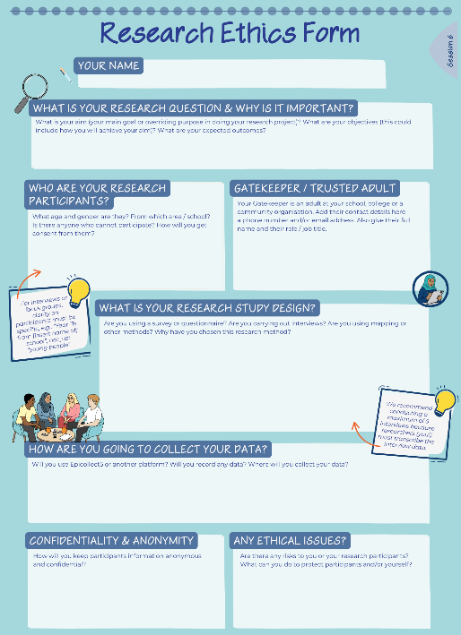
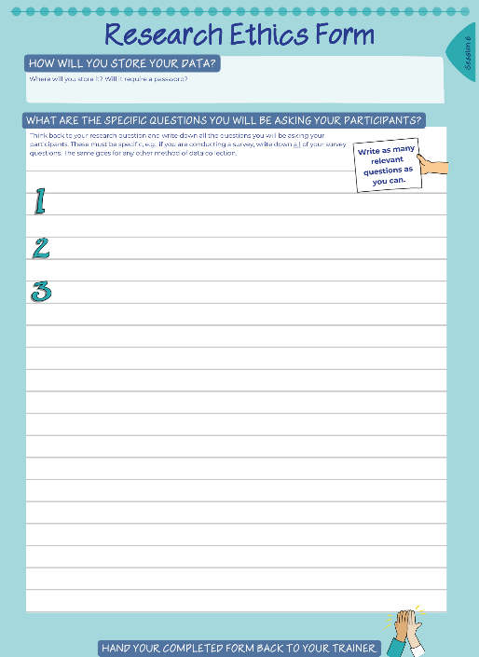
Activity 3: Ethics form
Your next task will be to begin filling out the ethics form using the information provided.
Notes:
With all that in mind, our next activity is to start filling out your ethics form, which can be found in the Session 6 activities in your workbook.

Slide 14

Ethics form – Information required
You will need to find answers to the following questions:
What is your research study design? (E.g., survey, interviews or other method(s))
What is your research question and why is it important?
Who are your research participants going to be?
What are the SPECIFIC questions you will ask your participants?
Who will your Gatekeeper be? (Note: Full name & job role/title are required.)
How are you going to collect your data? (E.g., Epicollect5 / Qualtrics)
Notes:
They key to completing your ethics form is to be really specific about all the different aspects of your research.
If you have names of participants, please state them and explain their relationship to you.
Use your exact research question and ensure you have your gatekeeper confirmed, if you are needing one.
Make sure you know exactly what research methods you are using and have a list of the exact questions you are using, as well as how you are going to store your data and ensure confidentiality and safety for all involved.

Slide 15
Guidance to help with your ethics form
What is your research question and why is it important?
Give the title of the question first!
Outline the background of your project in this part of the form. You also need to think about:
What is your aim?
What are your objectives?
What are your expected outcomes?
Aim & objectives
Study design
Title of your project
Research question
Why this question?
Expected outcomes
Background
Notes:
[Notes for trainer: The slides from now on are all guidance related to the ethics form that students will begin to complete as the last activity in this session. Deliver the next 3 slides and then set the researchers off on the task of completing their ethics form. If required, print these
The first question is all about your research question and its importance.
It is good practice to be really clear and specific about your question, what the aim of your research is, what objectives you are looking to achieve and the intended outcomes.
An objective is a measurable target that you hope to achieve by the end of the project.
An outcome is an impact that you hope to achieve, as a result of achieving the objectives.

Slide 16



Guidance to help with your ethics form
Who are your participants going to be?
How will you identify them, how will you approach them, how will you ensure representation?
What is your research study design?
This is all about your methods.
Are you using a survey or a questionnaire?
Will you carry out interviews?
Are you using mapping or other methods?
Why have you chosen this research method?
What are the specific questions you will be asking your participants?
You need to write out the questions you are planning to ask – everything needs to be approved before any data can be collected.
Notes:
What is your research study design? This is all about the research methods you are going to use. Will you be using surveys, questionnaires or interviews, or something different?
[click] Next, you will need to explain who your participants are goint to be. Do you have anyone specific in mind? Will it be an anonymised survey that goes out to the whole school?
[click] Your ethics form will need to have the exact questions you are going to ask.
[click] This is important, as these questions will need to be reviewed before they are approved for use.

Slide 17

Guidance to help with your ethics form
How are you going to collect your data?
Next session we will be talking more about Epicollect5 and Qualtrics.
Epicollect5 is suitable for interviewing, entering survey answers, short questionnaires, taking photos of mapping data and recording answers.
Qualtrics is suitable for longer questionnaires / surveys that you would like participants to complete without your assistance.
How will you store your data?
Where will you store it? Will a password be required?
How will you keep your participants’ information anonymous and confidential?
You will be using pseudonyms or aliases, so that data are not associated with a real name.
Notes:
In the next session, we will explore some different ways you can collect and store your data.
Epicollect is a suitable app for interviewing and entering short survey answers, as well as adding photos and short questionnaires.
Qualtrics is best used for longer questionnaires or surveys, where you do not necessarily need to be present for participants to complete.
[click] How are you planning on storing your data? Will you need a password to access the data? For example, you may decide to keep it in a TEAMs folder on a password protected Excel file.
You will need to use pseudonyms or aliases for your participants, to ensure that they are kept anonymous and confidential.

Slide 18



Guidance to help with your ethics form
Can you identify potential ethical issues in your study?
Are there any risks to your research participants?
Are there any risks to you?
What can you do to manage these risks and to protect participants and/or yourself?
Are there any inherent biases or discrimination affecting your study?
Who will your Gatekeeper be?
They should be someone that can ensure informed consent is received from appropriate participants.
Documents for your participants
You will need to prepare participant information sheets and consent forms which you or your Gatekeeper will distribute to your participants.
Notes:
What are the potential risks to your participants? Are there any risks to you? It is important that both researchers and participants are kept safe throughout the research process.
[click] Has a gatekeeper been identified for you and have they confirmed their role and duty? If so, you will need to state this in your form.
[click] Participant information sheets and consent forms will be necessary for you to proceed with your research. These need to have specific information, to ensure that the participant is completed informed about the project and has enough information to make an informed decision about their involvement with your research.

Slide 19
Activity 3: Your turn...
Time to start completing your ethics form (to be finished as part of your self-directed tasks)
Notes:
You can use the remainder of this session to complete as much of your ethics form as possible, and you will have time between now and the next session too.

Slide 20


Self-directed tasks
Complete the ‘Ethics competency’ quiz.
Complete your Research Ethics Form that you started in the session.
Watch the NxtGen Epicollect5 video (https://bit.ly/LifeLab_NxtGen_Epicollect) & answer the below questions.
Read the example of a topic guide provided and answer the questions.
Complete an entry in your Reflection Log.
Notes:
Your tasks before the next session are:
To complete your ethics form, get in touch with us if anything is unclear or if you need help
Complete the ethics competency quiz. To do this, scan the QR code in your workbook to access LifeLab's website. If asked, access the quiz as a guest. When completed, select the “print results” button on the results slide, screenshot the page and send it to me [NxtGen trainer] so I can log your results. Link to the ethics competency quiz: https://bit.ly/NxtGen_Ethics_Competency_Quiz
Complete the other self-directed tasks for Session 6 in your workbook
Watch the Epicollect video and answer the questions in the workbook, and
Complete your reflection log entry in the workbook.

Slide 21


Feedback
Name one future aspiration you have for yourself.
Write it on a post-it note and stick it up on the wall.
On one post-it note per statement, please:
Tell us one thing you enjoyed today / learnt / found interesting
Tell us one thing we can improve on for next week
Notes:
Please grab some post-it notes, to give feedback on today's session.
One note for one thing you enjoyed today, found interesting or a new thing you have learned.
Another note for one thing that could be improved on for the next session.

Slide 22
With thanks and acknowledgement of the generous support and funding from:

