Slide 1
Vaccines
Objectives:
To define the term ‘vaccine’
To explain how a vaccine works
To describe how a vaccine is developed
To discuss how vaccines can help you and your community

Slide 2
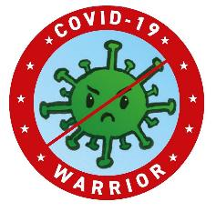

Video Introduction
Watch the COVID-19 Warriors Video Introduction

Slide 3
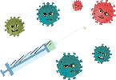
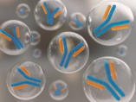

How do vaccinations work?
Vaccination is the safest way to protect children against infectious diseases.
Once you are vaccinated, you are likely to have some immunity to the disease.
You are given a small amount of a form of a germ, then your body makes antibodies to fight it off.
Then, if you get the disease again, your body already has the antibodies which makes you less likely to get sick.
You are immune.

Slide 4
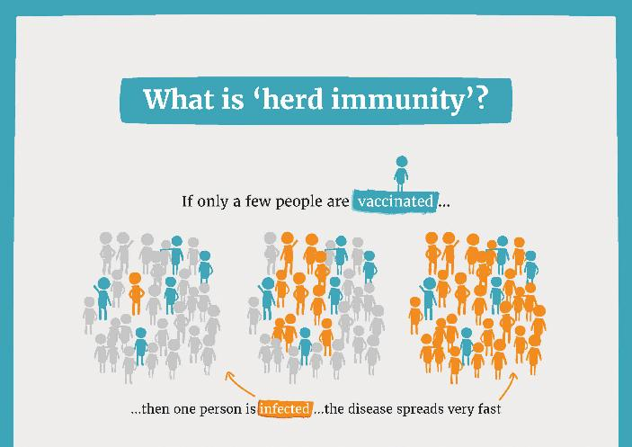
Why do we vaccinate?

Slide 5
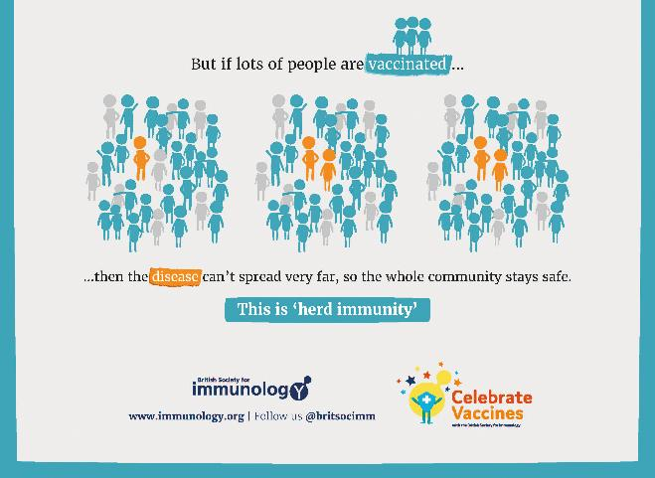
Why do we vaccinate?

Slide 6

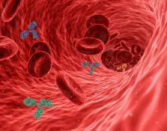
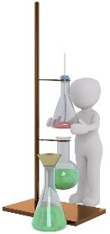
How is a vaccine developed?
This builds your immune system and means that if the germ tries to infect you again your body will recognise it and fight back without you getting ill.
The most important ingredient in most vaccines is the antigen which can be used to help your body build the right antibodies to fight the disease.
Antibodies travelling in the blood
The antigen is mixed with other ingredients to make a vaccine.
Scientists start by doing tests to find the antigen that will help.

Slide 7



How is a vaccine developed?
The vaccine is tested using cells, then tested on human volunteers in 3 Phases.
Phase 1
20-50 people are given the vaccine.
Side effects are recorded.
Recipe is checked.
Decisions are made: injection, a tablet or nasal spray.
Changes are made as needed after each phase of testing to make the vaccine safer.
Phase 3
Groups of thousands of people are given the vaccine.
A bigger variety of population groups covered.
Phase 2
Groups of several hundred people are given the vaccine.
Focussed on age and gender.

Slide 8

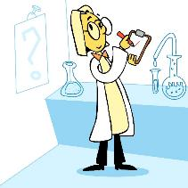
How is a vaccine developed?
The vaccine is checked by experts in each country who decide whether it is safe to use.
In the UK we have 2 bodies who check safety and give advice on vaccines:
The Medicines and Healthcare Products Regulatory Agency (MHRA)
The Joint Committee on Vaccination and Immunisation (JCVI)
The safety of the vaccine is continually measured. If anyone has any side effects following the vaccine, they are asked to report them using the 'yellow card' system.

Slide 9

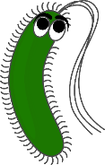
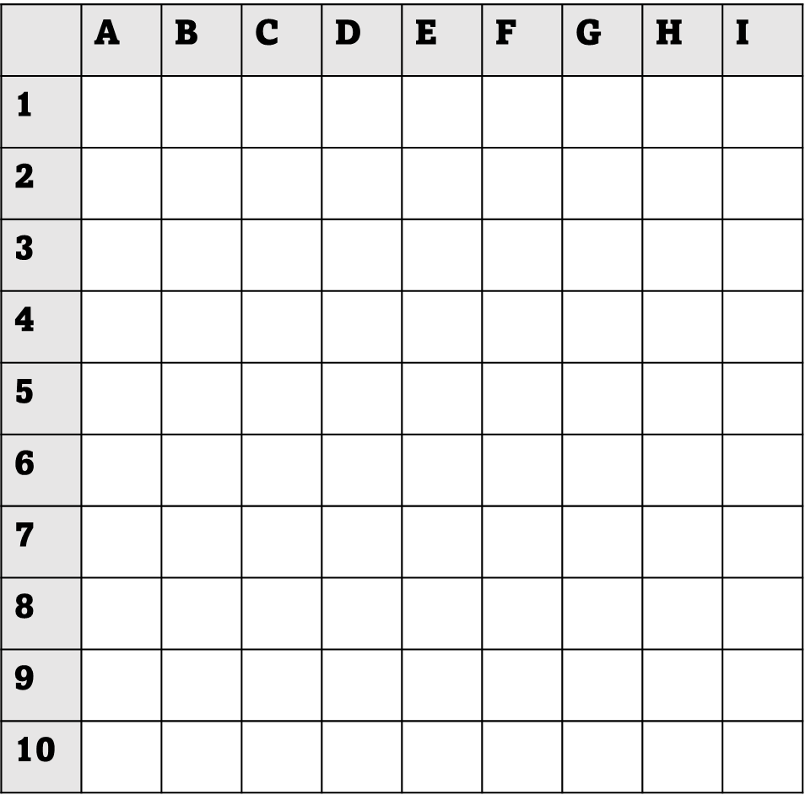
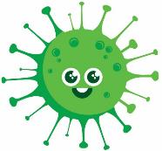
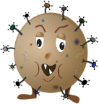
Main Activity
flu
whooping
cough
Find a partner and use germs to play a game of battleships.
Stop when you hear the noise!
measles
coronavirus

Slide 10
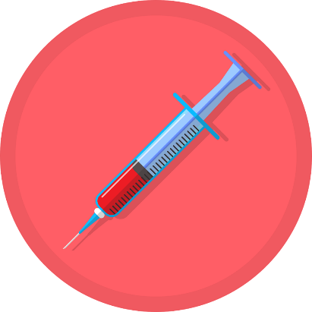
Vaccinated!
You have been vaccinated!
Now your body can recognise the germs and fight them more easily!

Slide 11
You can now:
Explain to your partner what a vaccine is and how it works
List the important steps in how a
vaccine is developed
Talk about how vaccination can help you and your community

Slide 12
Ace says “Make sure your vaccines are up to date to keep yourself, friends and family healthy.”

Slide 13
Bye,
see you soon!

Slide 15
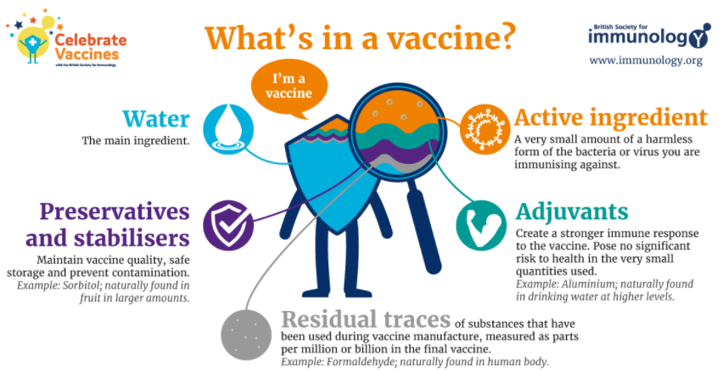
Extra Information

