Slide 1
Vaccines
Objectives:
To explain in simple terms how a vaccine works

Slide 2


Video Introduction
Watch COVID-19 Warriors Video Introduction

Slide 3

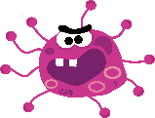
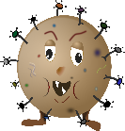
Main Activity
Let’s play a game!
Let’s pretend some intruder germs got into your classroom!
Choose one person to find them,
then hide the germs.

Slide 4







The 'Finder' must keep their eyes closed
while you hide the germs.
No peeking!
Now open your eyes and try to find the germs!
You could use a timer and see how long
it takes to find them all…

Slide 5


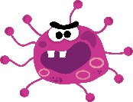



Now – let’s pretend you have the help of the ‘Vaccine’ to find the germs!
Make a ‘Vaccine’ headband
Vaccine
Hide the germs in a different place…

Slide 6


Play “Hot, Hot, Cold!”
Just as a vaccine helps the body see the germs, now the ‘Vaccine’ can help to find the hidden germs by guiding the ‘Finder’.
If they get closer to where the germ is hiding, say “Warm”, if they get even closer – “Hot” and if they are nowhere near the germ, its “Cold”.
Use a timer to see how long it takes to find all the hidden germs now!

Slide 7

Results time!
Which way was quicker to find the germs?

Slide 8
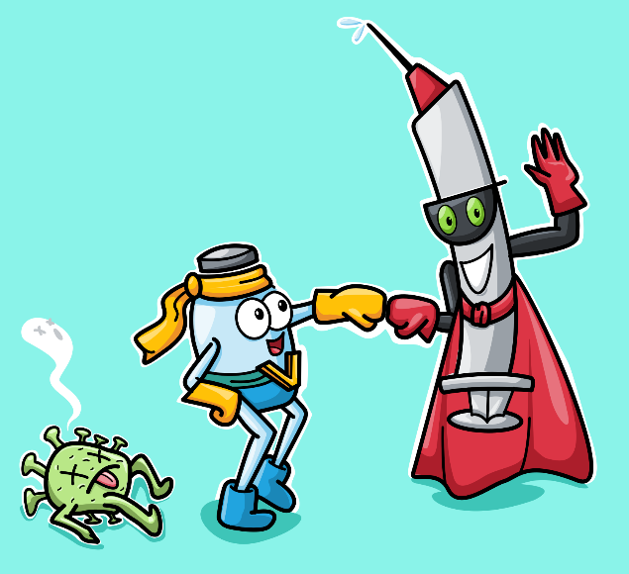
What have we learnt?
Can you tell your partner in your own words how a vaccine works?

Slide 9

Well done for learning about vaccines – another superpower tool we have to keep healthy!

Slide 10
Bye,
see you soon!

Slide 12

Extension Activities
Set up a Lab – use different pots/tubes, add water and a little bit of paint to make different vaccines.
What germs will your vaccines defeat – can you draw the germs?
Make labels for the new vaccines you develop.

