Slide 1


Coronavirus
Vaccines

Slide 2
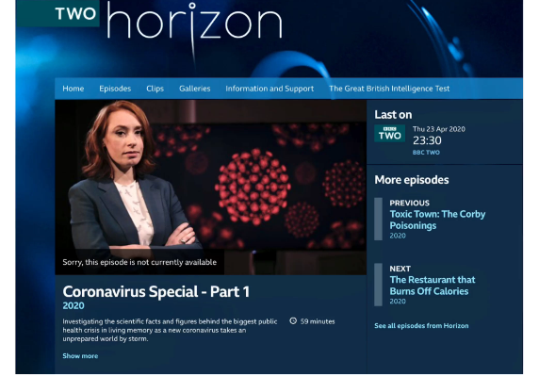
How about vaccines…….?
This video clip, featuring Dr Hannah Fry, was taken from the BBC Horizon Coronavirus Special part 1, first broadcast on 9th April 2020
BBC Two - Horizon, 2020, Coronavirus Special - Part 1, How Do Vaccines Protect the Population?

Slide 3
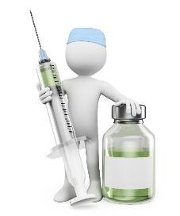
Vaccination key facts
The Coronavirus COVID-19 vaccine gives you the best protection against getting ill from the virus
Vaccinations give more protection to a population when a higher percentage of the population has been vaccinated. The more people who have been vaccinated, the less flare-ups of the disease. This is called ‘herd immunity’.
Until scientists know if the vaccine prevents transmission of the different variants we should still be cautions and try to limit the spread as much as possible.

Slide 4
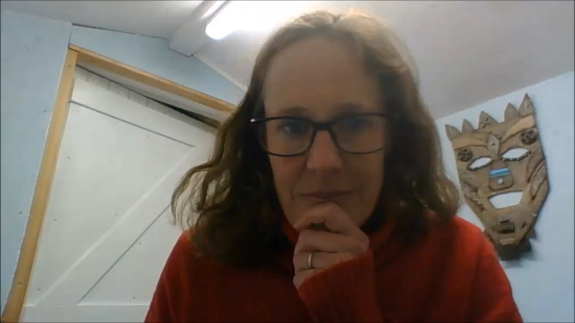
Why are vaccines important?
Kate Glyn-Owen is a Public Health Doctor and explains why a vaccine is important to stop the spread of coronavirus
https://youtu.be/J6DVaN38brs (2mins 41secs)

Slide 5
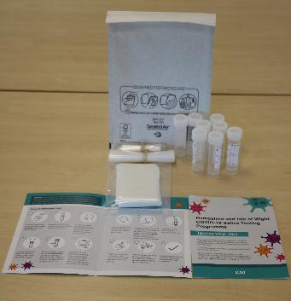
#BePartOfTheSolution
Please remember to do a test!
You are helping to stop the spread.
This work is funded by the Department of Health and Social Care and the National Institute for Health Research (NIHR). The views expressed are those of the authors and not necessarily those of the Department of Health and Social Care or NIHR.

Slide 6
Master slide: 1 custom design
= with footer
Notes:
NB. Layout master slide: 2 custom design = without footer

